Slide 1
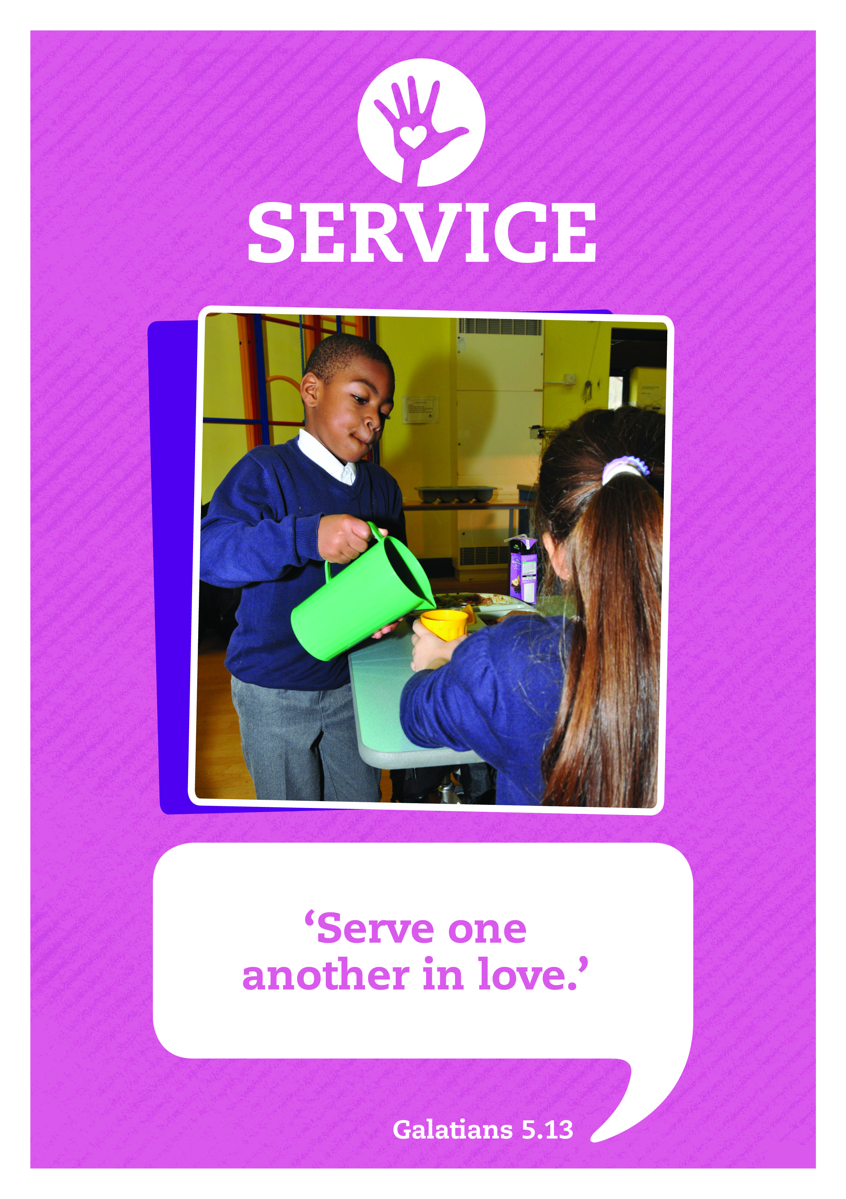



Music: Clarinet Concerto Adaglo
Composer: Mozart

Slide 2



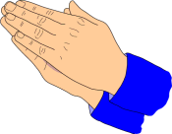


Care
This day may we know:
the love of God our Father,
the gift of God’s Son, the Servant King,
And the freedom of God’s own Spirit.
Inspire
Achieve

Slide 3
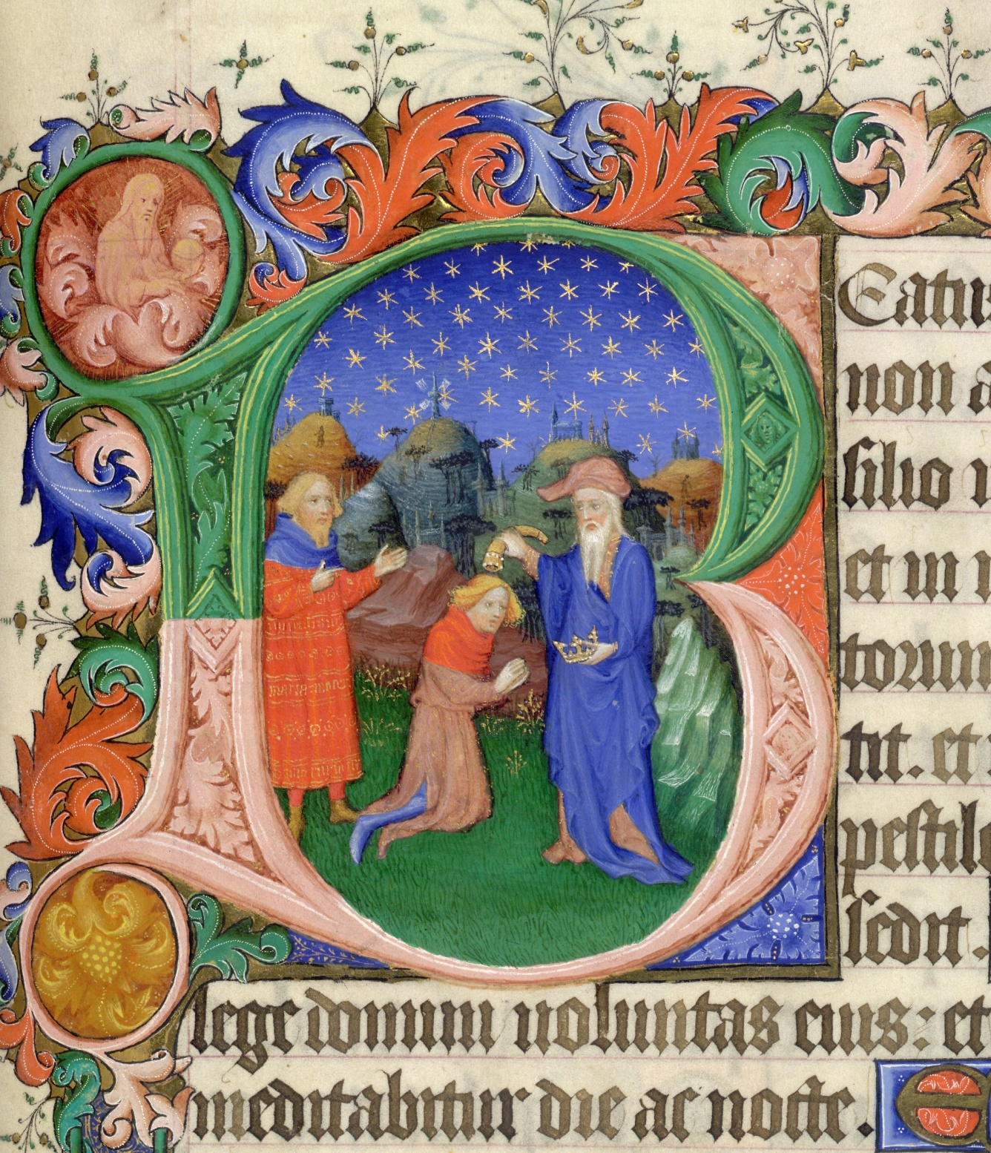
Today’s picture is taken from a medieval book or manuscript, created in the early 15th Century as a gift for the Duke of Bedford.
The book was full of Bible stories written in this beautiful script and illustrated with vey detailed paintings. The picture shows David being anointed by Samuel. David was being given a very special job, although he was still a young boy growing up and working to tend his father’s sheep.

Slide 4
Look carefully and you will spot some details
Samuel, David and Jesse all have some blue clothing which is a symbol of royalty.
Samuel is holding a crown in one hand and appointing David with oil from a horn in the other hand.

Slide 5

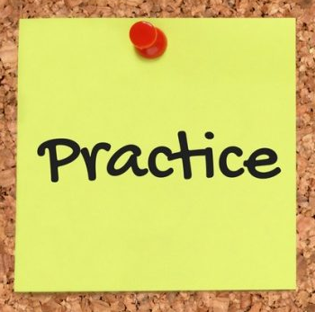
Story: A new King
I’ll now read the story of A new king.
Please join in with the words that appear in red.
But God’s thoughts were not his thoughts.

Slide 6
Story: A new King
Samuel was searching for a king to rule over the land and people. The king needed to be…
Strong
Brave
Good
Samuel thought he knew just what he was looking for.
But God’s thoughts were not his thoughts.

Slide 7
God told Samuel to go to Bethlehem, to the home of Jesse who had many sons.
“That’s good” thought Samuel. With all those fine sons to choose from, surely one of them would be just the king that the nation needed.
The seven sons Jesse called were handsome, strong and brave. It seemed to Samuel that any one of them would make a good king.
But God’s thoughts were not his thoughts.

Slide 8
“You are looking at how handsome and strong these young men are,” whispered God to Samuel, “but I am looking at their hearts. I am wondering if their hearts are so full of love that they will keep my laws and always serve my people.”
When all the men had stood before Samuel, God’s voice came again to the prophet.
“Ask Jesse if he has more sons,” he whispered.
”Why yes I do,” said Jesse, “there is young David but he is in the field watching the sheep.”
“Send for him” said Samuel firmly.
So they all stood around and waited until eventually David arrived

Slide 9
“He’s the one,” whispered God to Samuel. “Pour oil on his head to anoint him as king.”
“He’s very small and young,” thought Samuel.
“He’s not who I would have chosen,” thought Jesse.
But God’s thoughts were not his thoughts.
Then Samuel remembered God’s words to him. “I am looking to the heart.”
Only God could see that young David had a heart of love and would be a servant king to his people.

Slide 10


Take a moment to reflect and think.
There’s a saying, or proverb, which says:
You can’t judge a book by it’s cover.
What do you think this means?

Slide 11
God’s Plan, Our Prayer
David was the smallest and youngest in his family and yet Samuel saw that he was the one who would serve God and his people best as king. No one is too small, too young or too ordinary to be used by God in amazing ways.
Father God
You have great plans for all of us!
Help us by your Spirit, to serve you with our whole heart,
As we each play our special part.
Amen
I’ll now lead a prayer, listen and if you wish to make the prayer your own join in with the Amen at the end.

Slide 12

Let’s sing

Slide 13
Service: Sent By The Lord I Am
Translation © George Maldonado
Sent by the Lord am I;
My hands are ready now
To make the earth a place
In which the kingdom comes.
Sent by the Lord am I;
My hands are ready now
To make the earth a place
In which the kingdom comes.
The angels cannot change
A world of hurt and pain
Into a world of love,
Of justice and of peace.
The task is mine to do,
To set it really free.
O help me to obey;
Help me to do your will.
(Repeat 3 times)

Slide 14

Fruits from the Roots
Think about your life-line, not only the past but also your dreams and aspirations for the future.

Slide 15
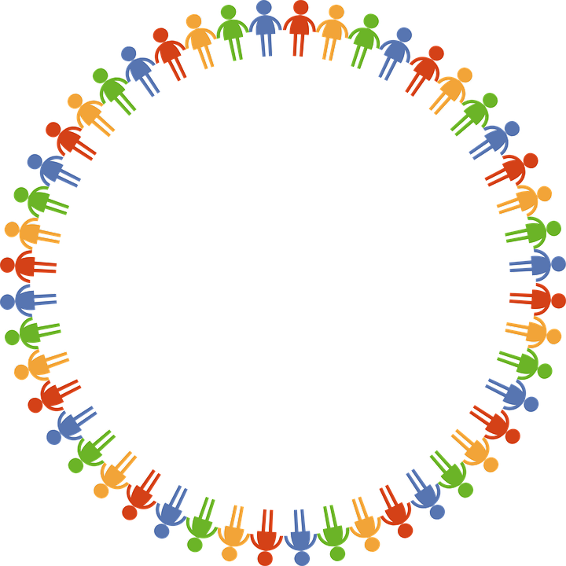
Dear God
Thank you for our school
and the amazing opportunities we have.
Thank you God
Thank you for all the work we do and the new things we learn.
Thank you God
Thank you for our church and school community.
Thank you God
Help us to make the right decisions.
Help us God
Help us to consider the needs of others.
and to be a good friend.
Help us God
Hear our prayer
Amen
Care
Inspire
Achieve

