Slide 1
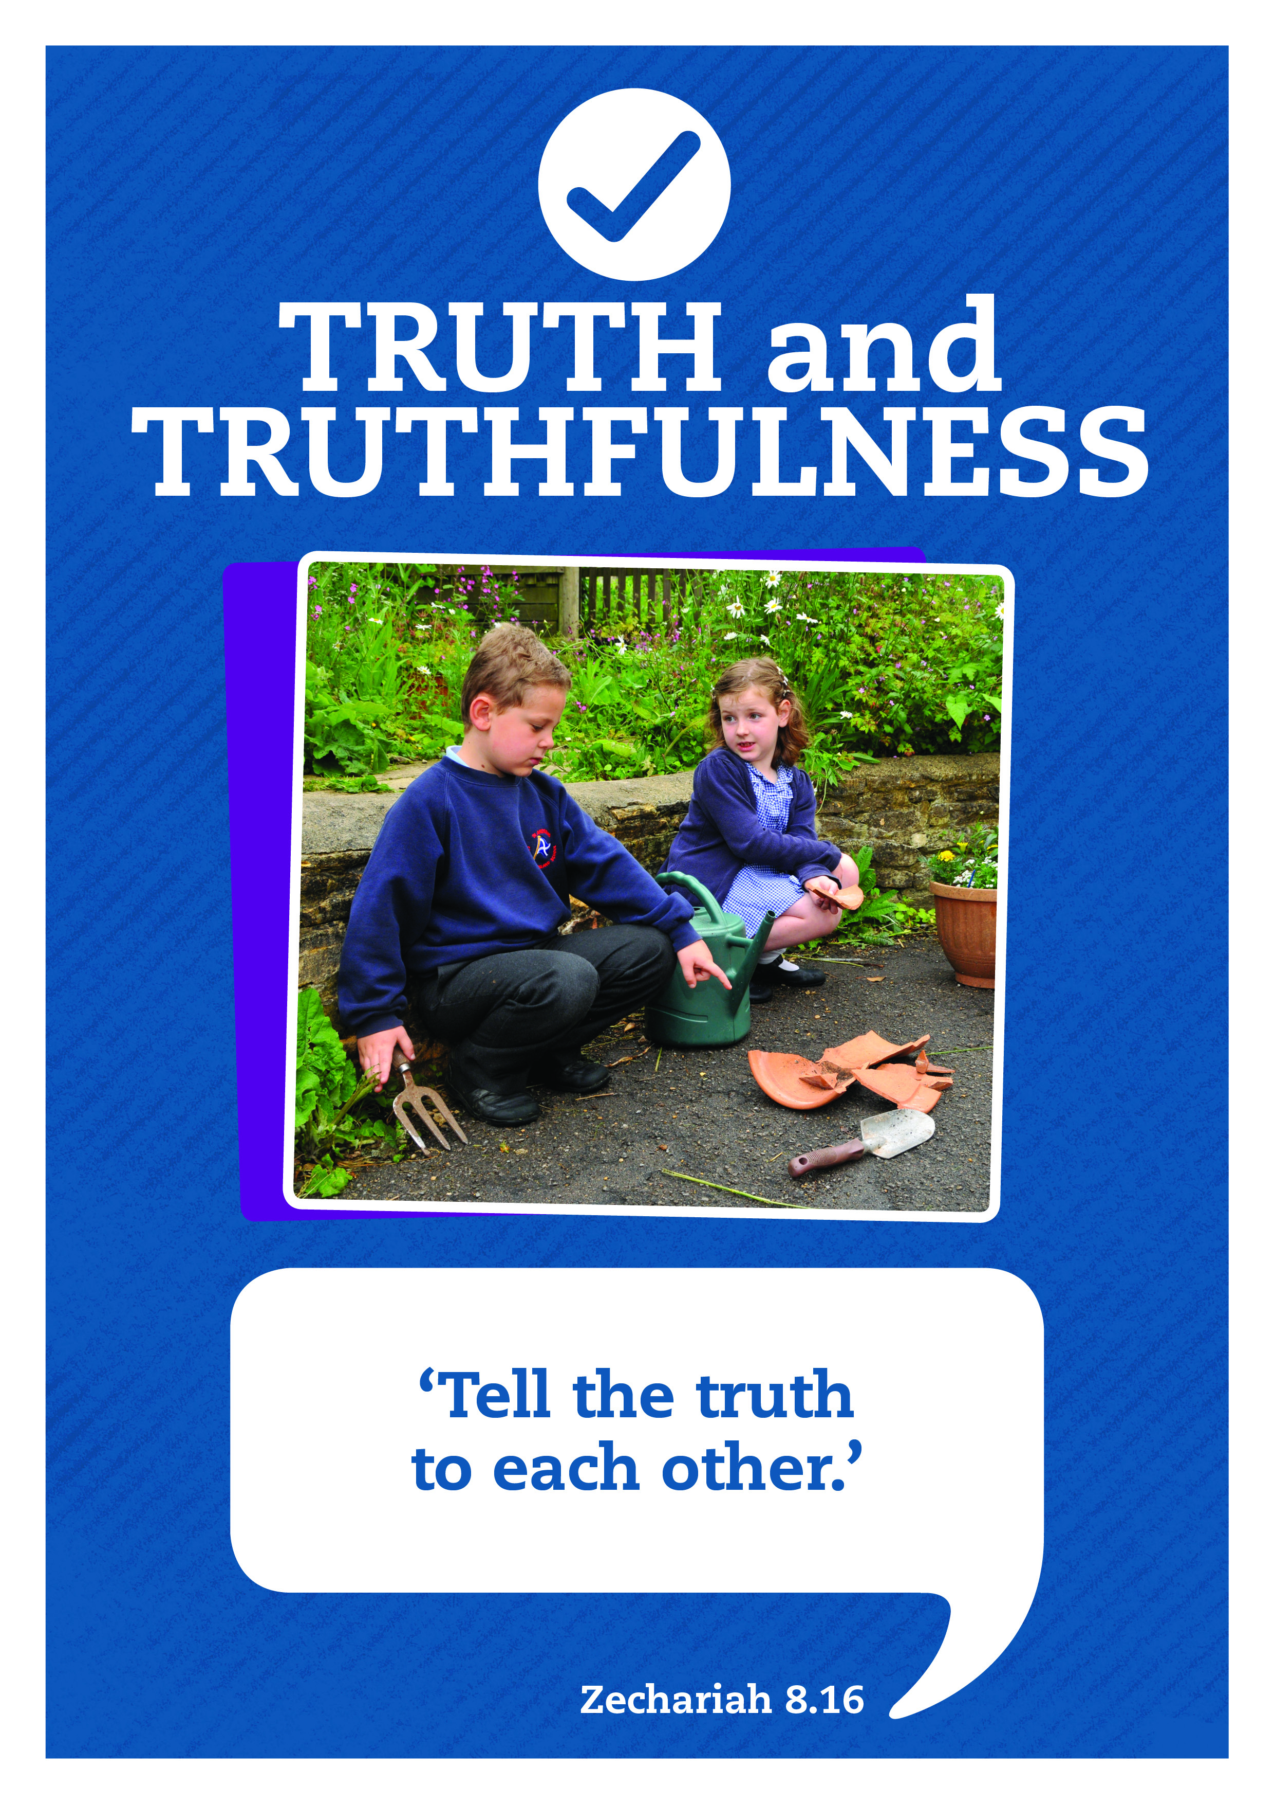

Slide 2






Care
We have gathered in the name of
God the Father, Son and Holy Spirit,
to worship together
and think about our value truthfulness.
Inspire
Achieve

Slide 3


We are thinking about truthfulness and lies.
Why do you think it is important not to tell lies?

Slide 4
As you listen and join in with today’s story, Jacob and Esau written by Bob Hartman, think about the results of lies that were told.
Porky Pie (Snort)
Porky Pie (Snort)
Someone’s telling
A great big lie (Snort)

Slide 5

Story : Jacob and Esau
Chorus
Porky Pie (Snort)
Porky Pie (Snort)
Someone’s telling
A great big lie (Snort)

Slide 6

Take a moment to reflect and think.
What do you think about the way each of the main characters in the story behaved?
Have you ever been tempted to tell a lie to get something that you want? How did it make you feel inside?

Slide 7
Honesty Prayer
God of truth,
We thank you for the peace we feel when we are truthful,
and the way you trouble us inside when we tell lies.
Give us courage to be honest, whatever the cost.
Amen
I’ll now lead a prayer, listen and if you wish to make the prayer your own join in with the Amen at the end.

Slide 8

Let’s sing

Slide 9

Truthfulness: Seek Ye First
written by Karen Lafferty
Seek ye first the kingdom of God
And His righteousness;
And all these things shall be added unto you.
Hallelu, Hallelujah!
Hallelujah, Hallelujah, Hallelujah,
Hallelu, Hallelujah!

Slide 10
Ask, and it shall be given unto you;
Seek, and you shall find.
Knock, and it shall be opened unto you.
Hallelu, Hallelujah!
Hallelujah, Hallelujah, Hallelujah,
Hallelu, Hallelujah!

Slide 11
You shall not live by bread alone,
But by every word
That proceeds out from the mouth of the Lord.
Hallelu, Hallelujah!
Hallelujah, Hallelujah, Hallelujah,
Hallelu, Hallelujah!

Slide 12
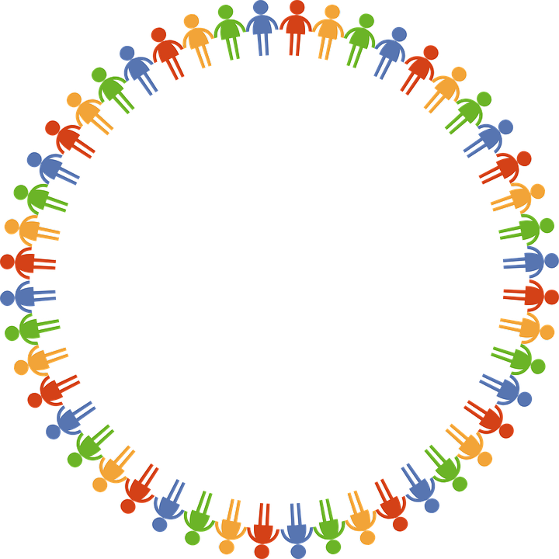
Dear God
Thank you for our school
and the amazing opportunities we have.
Thank you God
Thank you for all the work we do and the new things we learn.
Thank you God
Thank you for our church and school community.
Thank you God
Help us to make the right decisions.
Help us God
Help us to consider the needs of others.
and to be a good friend.
Help us God
Hear our prayer
Amen
Care
Inspire
Achieve

