Slide 1
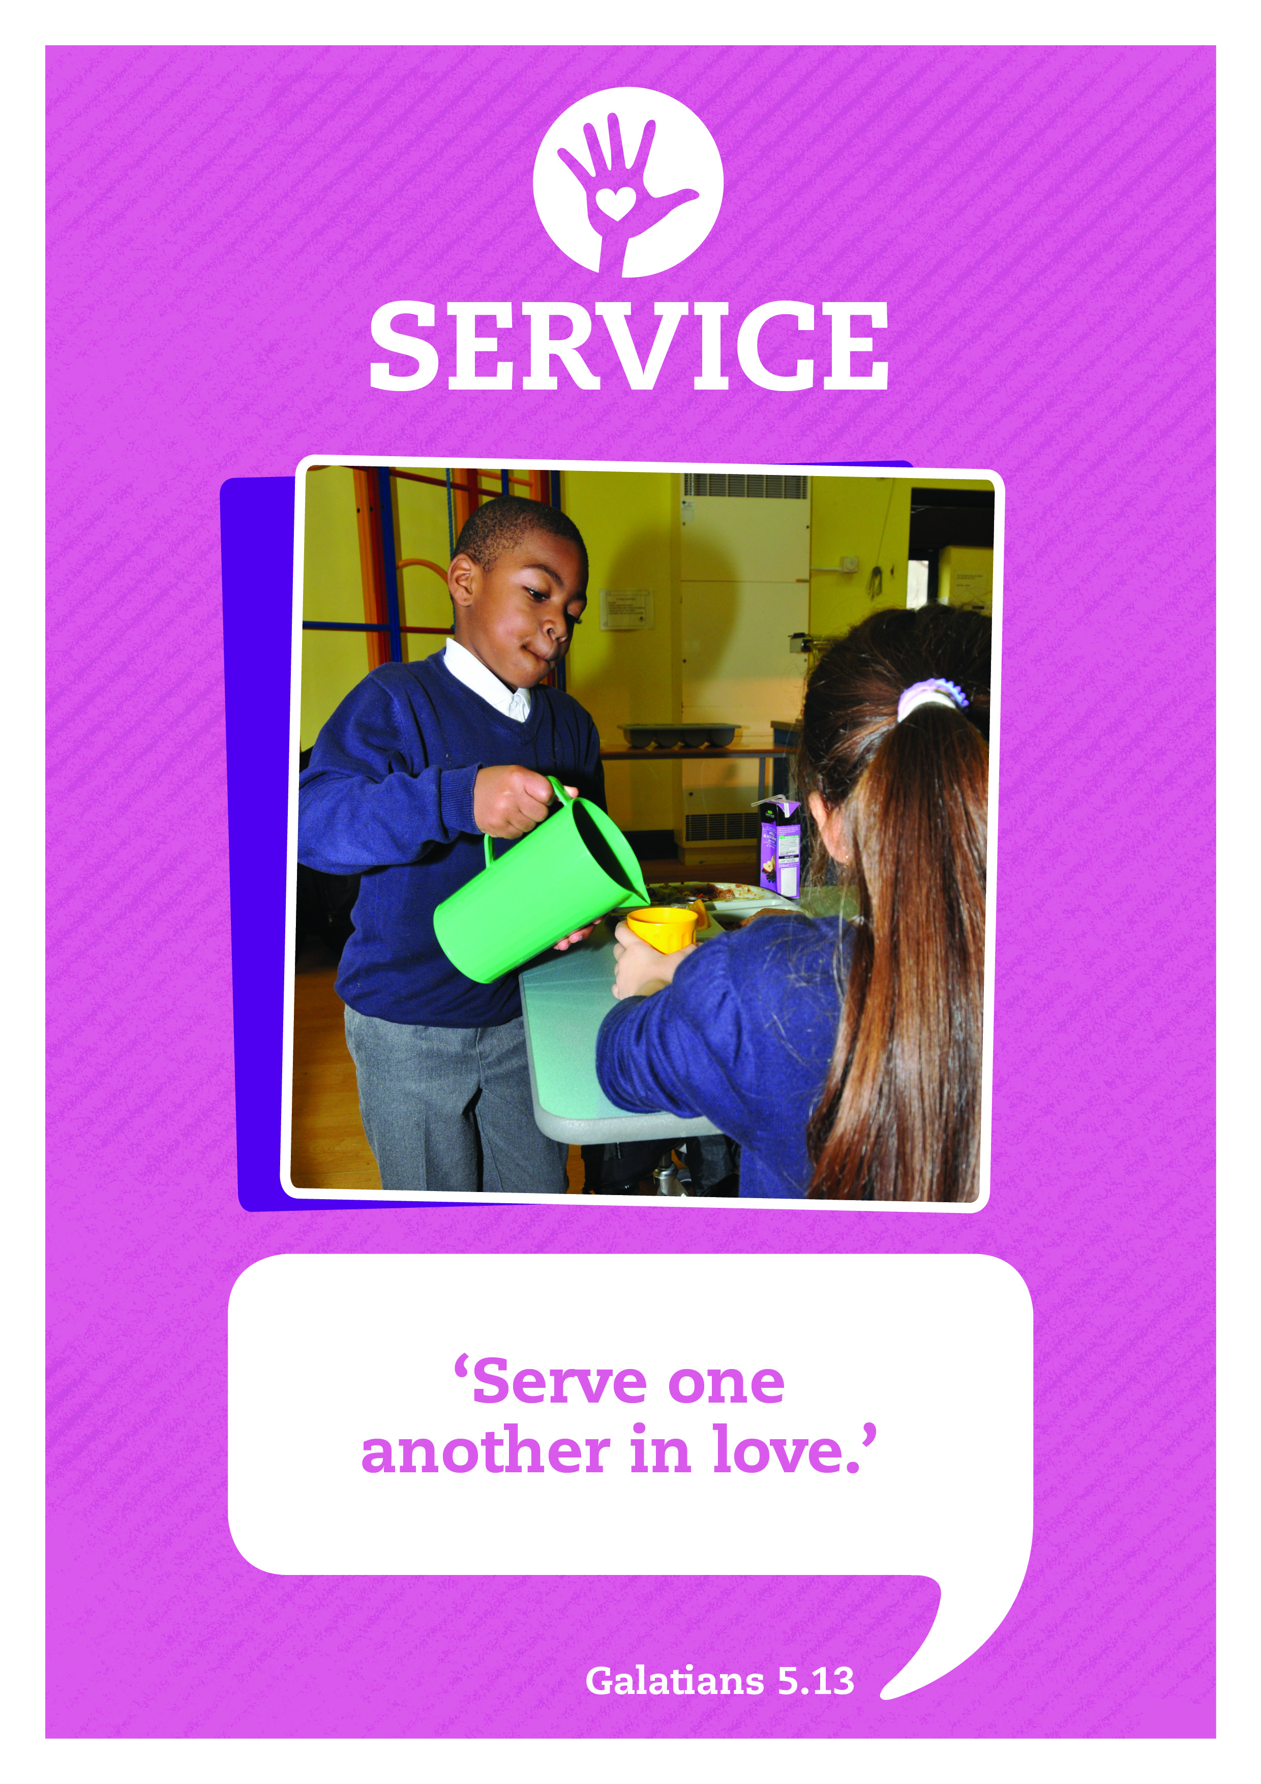


Music: Clarinet Concerto Adaglo
Composer: Mozart

Slide 2



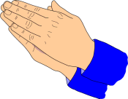


Care
We have gathered in the name of
God the father, Son and Holy Spirit,
to worship together
and think about our value service.
Inspire
Achieve

Slide 3

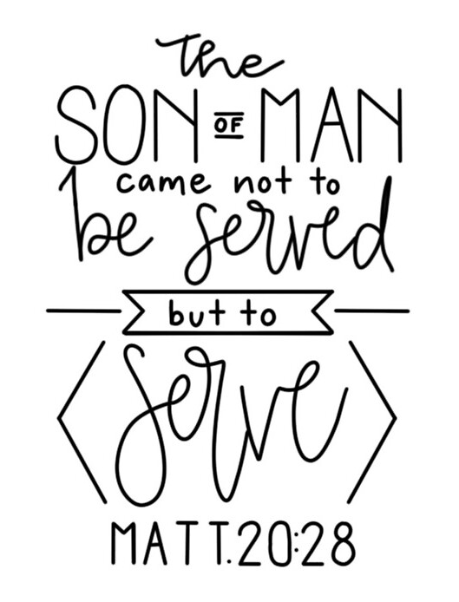
Jesus didn’t put any conditions on the way He served, there were ‘no strings attached’ and His love for us is the greatest gift he could give.
Following Jesus’ example, we too should give without expecting any reward.
This can take people by surprise as Rosie discovered.

Slide 4
Drama No strings attached
Narrator: Rosie’s Grandmother had given her £10 when she visited her all the way from Inverness in Scotland.
“Spend it in a way that makes you most happy” said her Granny.
I wonder how you would have spent the money?
Well you may be surprised about what Rosie did. The Value in Rosie’s school that term was Service. One of Rosie’s Mum’s friends had made dozens and dozens of muesli bars to sell to raise money for a charity called Christian Aid. Rosie decided to spend her £10 to buy a bar for everyone in her class.
At break time she asked her teacher if she could give out the bars.
Here’s what happened:

Slide 5
Drama No strings attached
Rosie stands with a tray of Muesli bars and Jon, Kate, Patrick and Ellie come along in turn.
Rosie: Would you like a muesli bar?
Jon: Yes, I love those. How much are you selling them for?
Rosie: They’re free, just a gift
Jon: Wow thanks Rosie!

Slide 6
Rosie: Hi Kate, would you like a free muesli bar?
Kate: Free! Yes please
Rosie: There you go
Kate: Thanks Rosie, I owe you!
Rosie: No you don’t, it’s a free gift.
Patrick: I heard you’re giving away free bars, Is it just to your friends?
Rosie: No to everyone. Want one?
Patrick: You bet!

Slide 7
Rosie: D’you want a muesli bar Ellie?
Ellie: Yes please, thanks Rosie. I’ll bring something for you tomorrow. One good turn deserves another!
Rosie: That’s OK. You don’t need to.
Ellie: Oh I get it (sarcastically), you’re trying to get lots of people to vote you on to the School Council. That’s why you’re giving out muesli bars.
Rosie: I’m not standing for the School Council.
Ellie: Oh sorry Rosie. It’s just that usually, when there’s a free gift there’s strings attached.
Rosie: I guess if there were strings attached it wouldn’t really be a free gift would it?

Slide 8

Take a moment to reflect and think.
Why do you think it was hard for Rosie’s classmates to understand that she wanted to give a gift without expecting anything in return?
A real gift is given with no strings attached.
One way of serving with ‘no strings attached’ is to serve in secret. In other words to give in a way that no one will ever discover who the giver was!

Slide 9
Prayer of St. Augustine
We will continue our worship with a famous prayer written in the fifth century by St Augustine. After he became a follower of Christ he devoted his life to serving, teaching God’s message and prayer.
Prayer of St Augustine
Eternal God, You are
the light of minds that know you
the joy of hearts that love you
and the strength of the wills that serve you.
Help us so to know you
that we may truly love you,
and so to love you that
we may fully serve you
through Jesus Christ our Lord,
Amen.
I’ll now lead a prayer, listen and if you wish to make the prayer your own join in with the Amen at the end.

Slide 10

Let’s sing

Slide 11
Service: Sent By The Lord I Am
Translation © George Maldonado
Sent by the Lord am I;
My hands are ready now
To make the earth a place
In which the kingdom comes.
Sent by the Lord am I;
My hands are ready now
To make the earth a place
In which the kingdom comes.
The angels cannot change
A world of hurt and pain
Into a world of love,
Of justice and of peace.
The task is mine to do,
To set it really free.
O help me to obey;
Help me to do your will.
(Repeat 3 times)

Slide 12
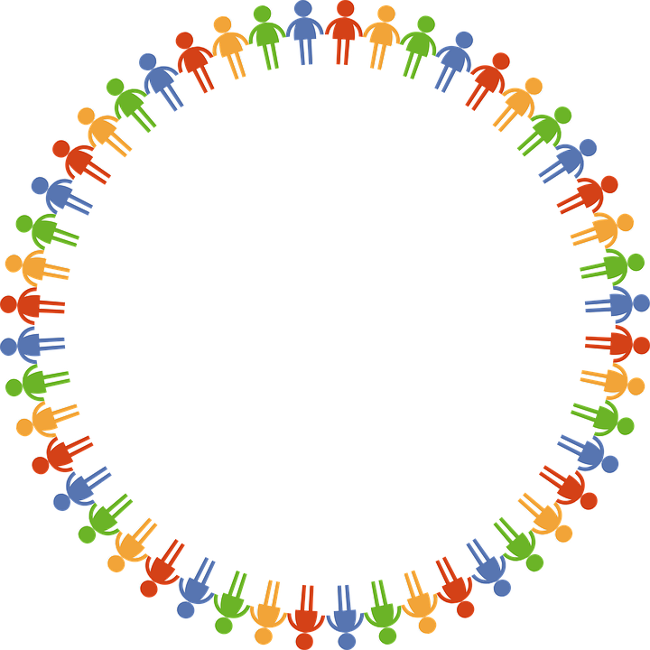
Dear God
Thank you for our school
and the amazing opportunities we have.
Thank you God
Thank you for all the work we do and the new things we learn.
Thank you God
Thank you for our church and school community.
Thank you God
Help us to make the right decisions.
Help us God
Help us to consider the needs of others.
and to be a good friend.
Help us God
Hear our prayer
Amen
Care
Inspire
Achieve

