Slide 1
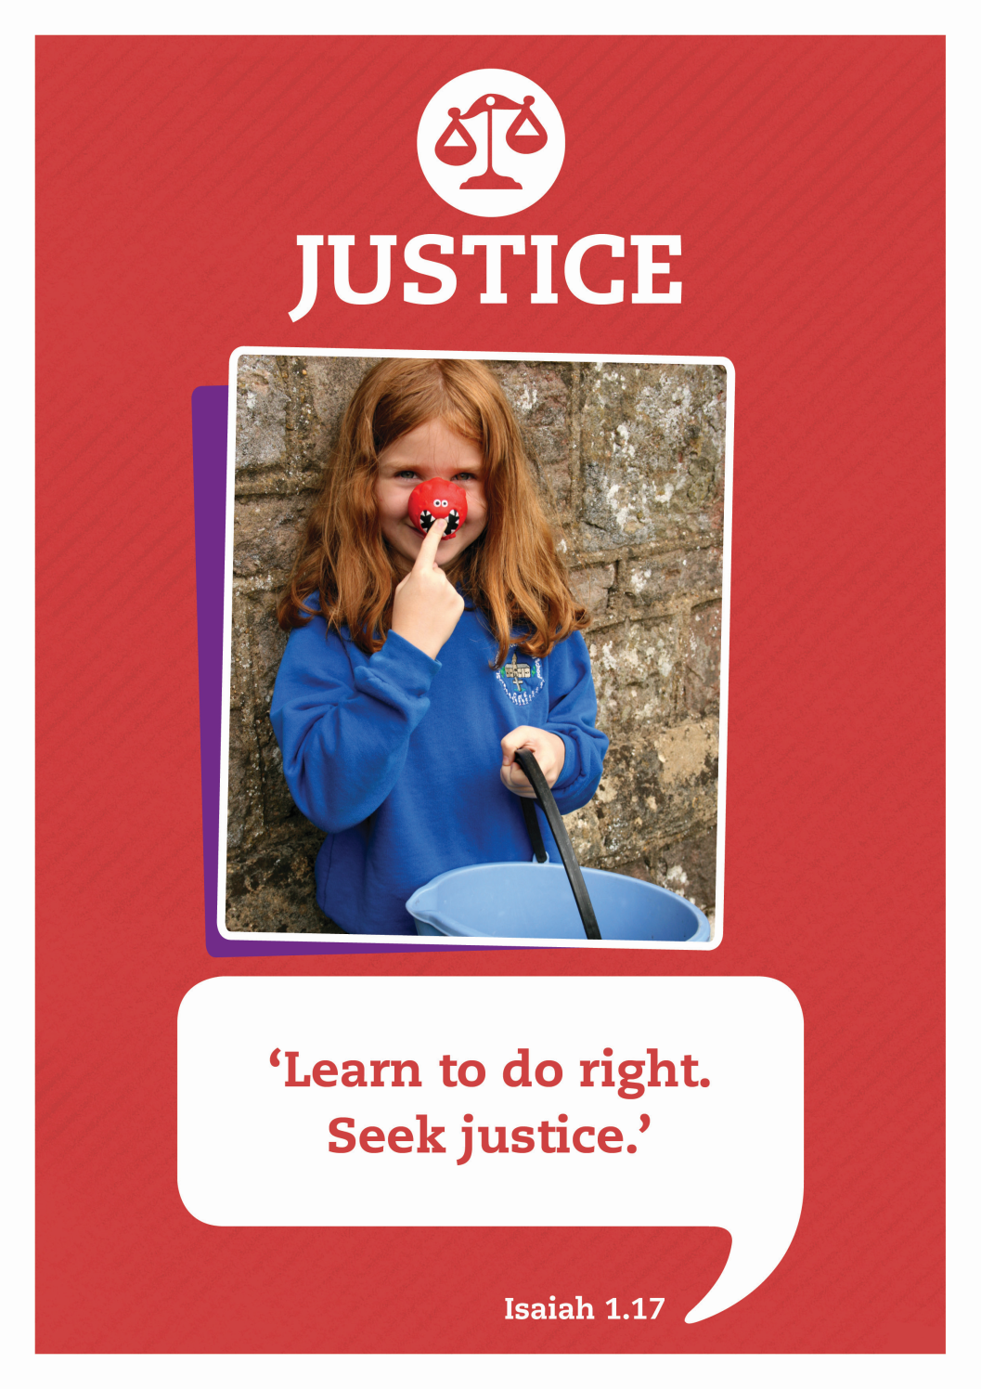

Slide 2



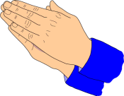


Care
We have gathered in the name of
God the father, Son and Holy Spirit,
to worship together
and think about our value justice.
Inspire
Achieve

Slide 3
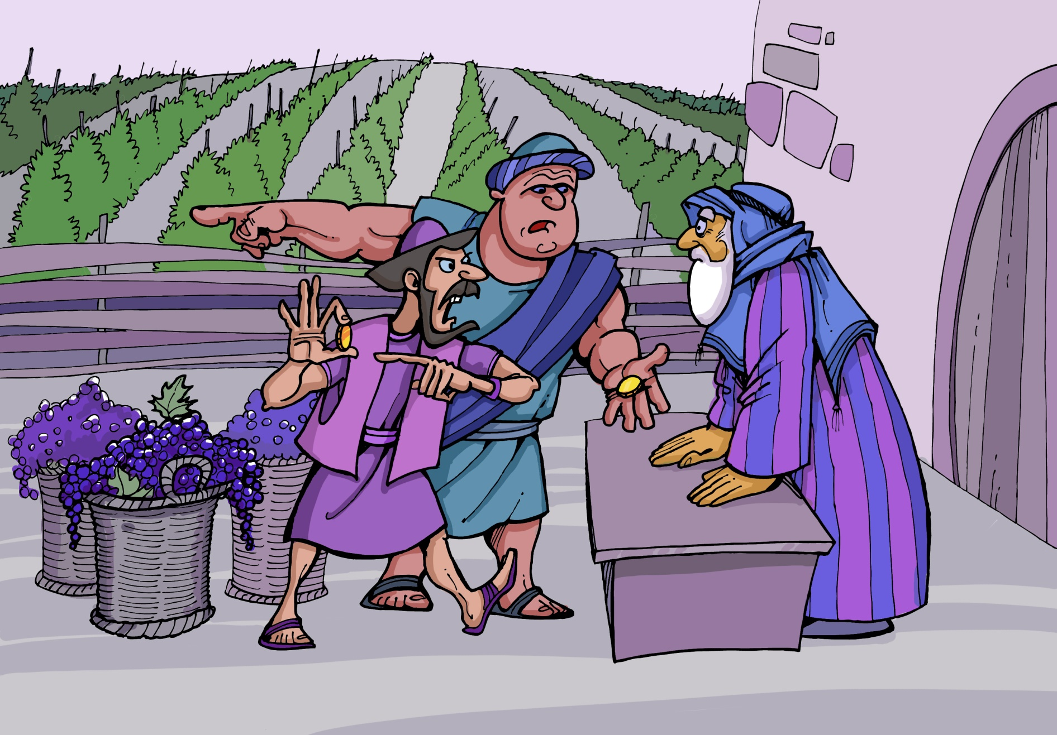
What do you think the men have been doing?
Why are they looking so cross?

Slide 4

This is an illustration of a story that Jesus told his disciples. It was about a vineyard. What grows in a vineyard?

Slide 5



Story: Harvest Time in the Vineyard

Slide 6

Reflecting
I wonder what you think about the way Jonah treated those who worked in his vineyard. Was it Justice?
Jesus told the story because he wanted his disciples to know that God’s love does not depend on what we do or don’t do. God’s idea of justice is to make everyone equal in his kingdom because his love is so generous. Jesus reminds us that we should be thankful for God’s generosity and not be envious or grumble about the good things that God also gives to others.

Slide 7
Lord, Your justice reaches to the heavens,
Your faithfulness into the clouds.
We give you praise for your generous love, that does not treat us as we deserve,
but gives us more than we could ever hope for.
Amen

Slide 8

Let’s sing

Slide 9

Justice: Celebrate Life
Written by Andrew & Wendy Rayner, Wendy House Music
We stand united; Children, as one
Future for all of the world.
We join together from every land
Part of the family of God.
Everyone precious, everyone loved
All of us known by our name.

Slide 10
Celebrate life, this gift we are living.
Celebrate hope, for all of mankind.
Celebrate love to share with each other.
Celebrate life, hand in hand.
We pray for freedom, mercy and peace
Justice for all of the world.
We ask God’s blessing on every land
Longing for each child to know
Everyone precious, everyone loved
All of us known by our name.

Slide 11
Celebrate life, this gift we are living.
Celebrate hope, for all of mankind.
Celebrate love to share with each other.
Celebrate life, hand in hand.
Celebrate life, this gift we are living.
Celebrate hope, for all of mankind.
Celebrate love to share with each other.
Celebrate life, hand in hand.
Celebrate life!

Slide 12
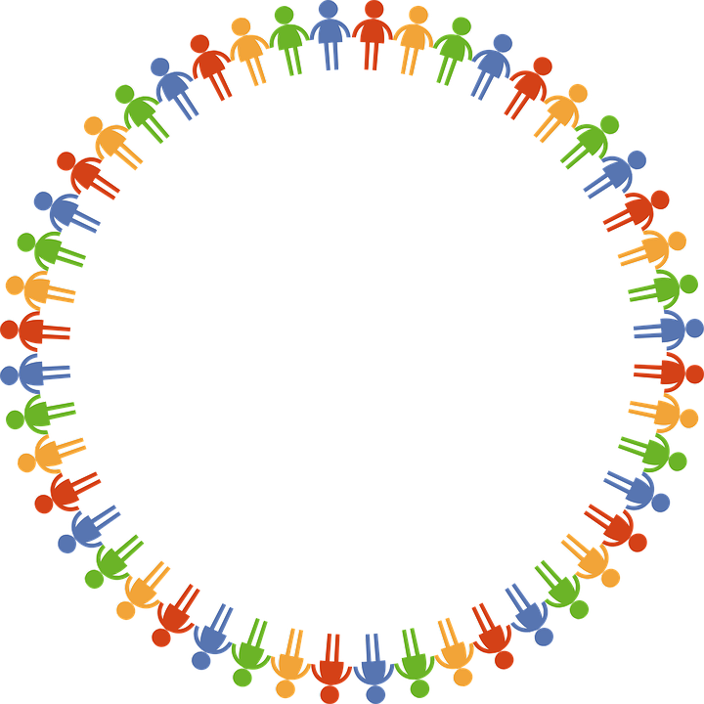
Dear God
Thank you for our school
and the amazing opportunities we have.
Thank you God
Thank you for all the work we do and the new things we learn.
Thank you God
Thank you for our church and school community.
Thank you God
Help us to make the right decisions.
Help us God
Help us to consider the needs of others.
and to be a good friend.
Help us God
Hear our prayer
Amen
Care
Inspire
Achieve

