Slide 1
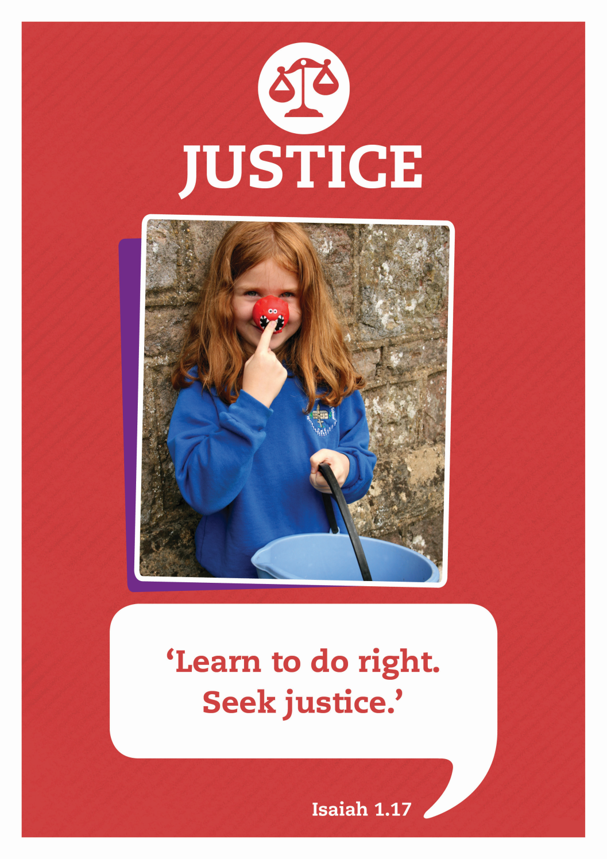

Slide 2



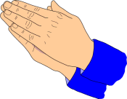


Care
We have gathered in the name of
God the father, Son and Holy Spirit,
to worship together
and think about our value justice.
Inspire
Achieve

Slide 3
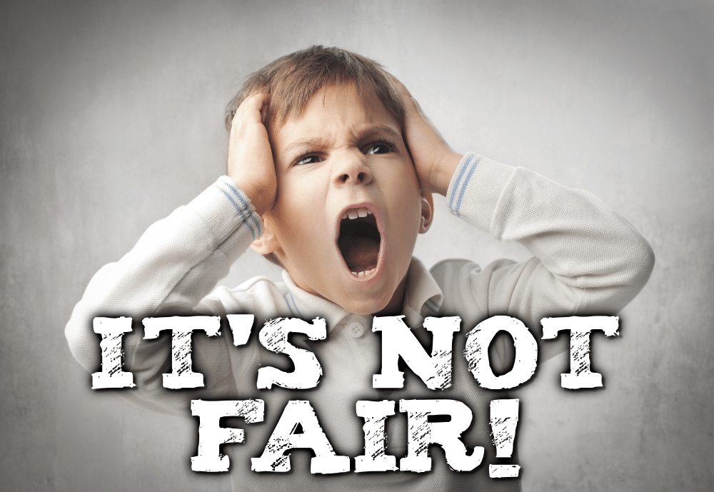
‘Has anyone said,
“It’s not fair” during the past week?’

Slide 4
Often when we think about this question the answers often start with the same word ‘I’.
‘It’s not fair, I don’t get enough pocket money!’
‘It’s not fair, I have to do the washing-up!’
In some ways, these answers are a bit selfish as they are all to do with what we want.

Slide 5

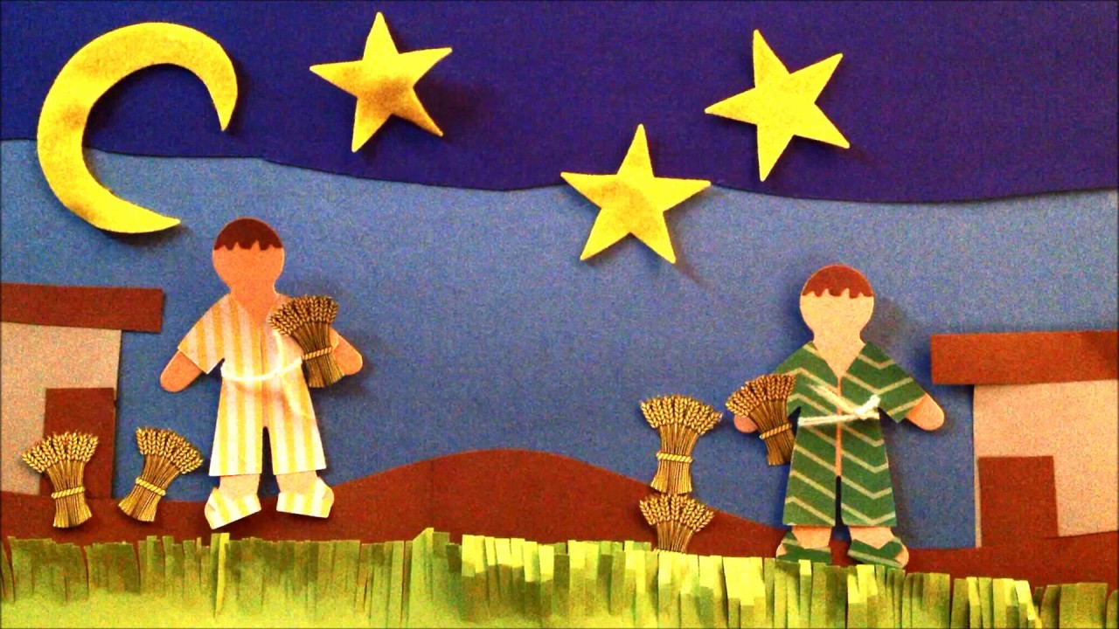
Story: The Two Brothers
This is an old Jewish folktale that interprets the phrase, ‘It’s not fair!’ in quite a different way.

Slide 6

Reflecting
The two brothers in the story did not use the phrase, ‘It’s not fair!’ in a selfish way. Instead, they used it in a positive way as they tried to do something to make the situation fairer or more just.
Sit quietly and think if there is anything they could do to make the world a fairer place. May be…
– you could try to treat everyone in your class fairly, not leaving anyone out or favouring particular people
– you could buy Fairtrade chocolate in the knowledge that the people who grow the cocoa beans – many of whom are children– will be treated and paid fairly
– you and your family could consider sponsoring a child who lives in a poorer country so that he or she, like you, could go to school and learn.

Slide 7
Dear Lord,
Thank you for all the wonderful things that we have.
Help us to be kind and considerate to others and
Please help us to make the world a fairer place to live in.
Amen.

Slide 8

Let’s sing

Slide 9

Justice: Celebrate Life
Written by Andrew & Wendy Rayner, Wendy House Music
We stand united; Children, as one
Future for all of the world.
We join together from every land
Part of the family of God.
Everyone precious, everyone loved
All of us known by our name.

Slide 10
Celebrate life, this gift we are living.
Celebrate hope, for all of mankind.
Celebrate love to share with each other.
Celebrate life, hand in hand.
We pray for freedom, mercy and peace
Justice for all of the world.
We ask God’s blessing on every land
Longing for each child to know
Everyone precious, everyone loved
All of us known by our name.

Slide 11
Celebrate life, this gift we are living.
Celebrate hope, for all of mankind.
Celebrate love to share with each other.
Celebrate life, hand in hand.
Celebrate life, this gift we are living.
Celebrate hope, for all of mankind.
Celebrate love to share with each other.
Celebrate life, hand in hand.
Celebrate life!

Slide 12
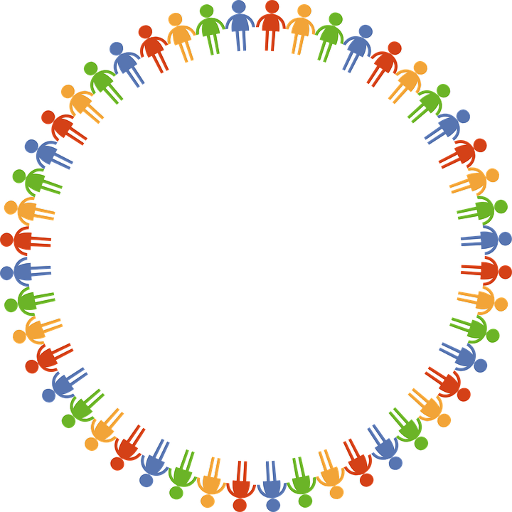
Dear God
Thank you for our school
and the amazing opportunities we have.
Thank you God
Thank you for all the work we do and the new things we learn.
Thank you God
Thank you for our church and school community.
Thank you God
Help us to make the right decisions.
Help us God
Help us to consider the needs of others.
and to be a good friend.
Help us God
Hear our prayer
Amen
Care
Inspire
Achieve

