Slide 1
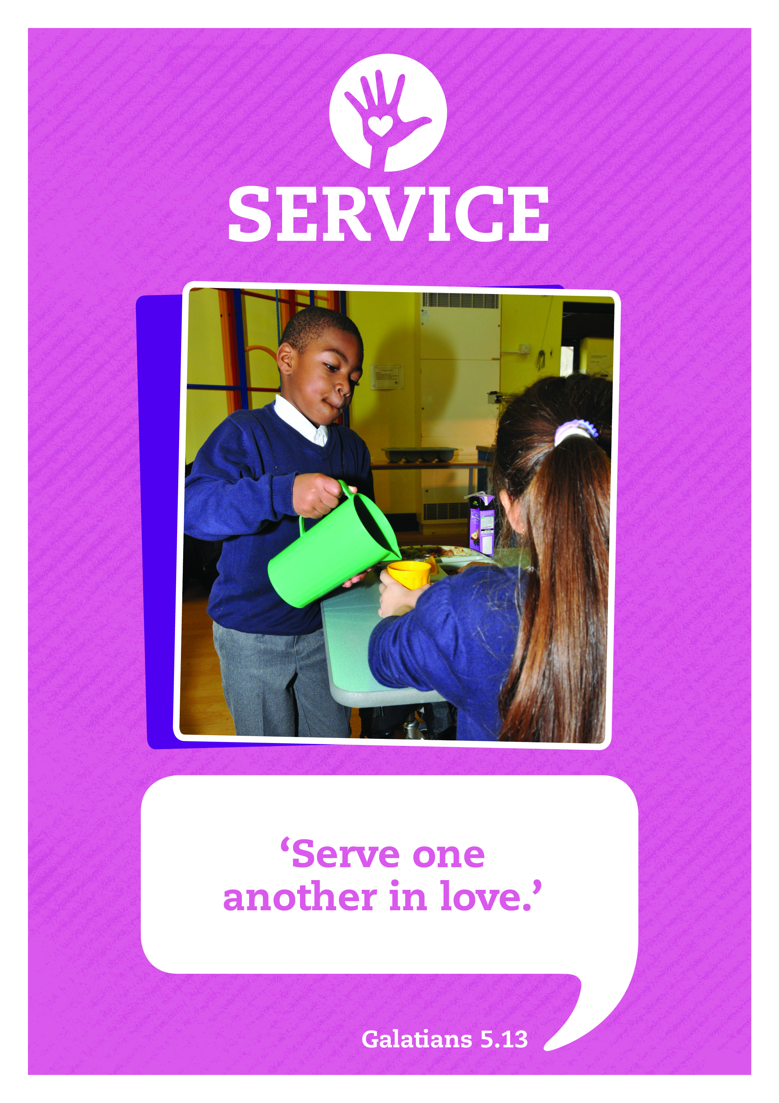


Music: Clarinet Concerto Adaglo
Composer: Mozart

Slide 2



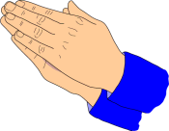


Care
We have gathered in the name of
God the father, Son and Holy Spirit,
to worship together
and think about our value service.
Inspire
Achieve

Slide 3

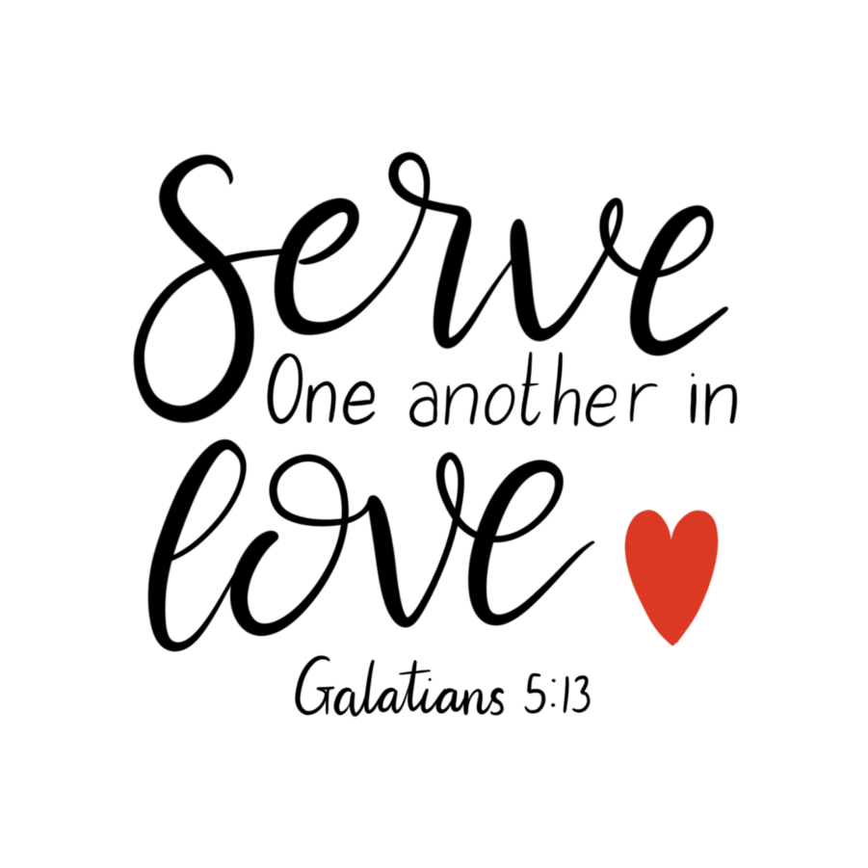
Today we are thinking about how relationships and friendships are made strong when we both give and receive from one another.

Slide 4

1 Kings 17 ⁷⁻¹⁶
We’re now going to hear Bob Hartman’s poem ‘Jugs and Jars’. It’s a retelling of the story from the Bible that we have just heard about a widow who serves by sharing all she had and was rewarded in an amazing way.
You’re going to help by joining in with the chorus.

Slide 5

Jugs and jars
Jugs and jars
Oil in the jugs
Flour in the jars
repeat

Slide 6

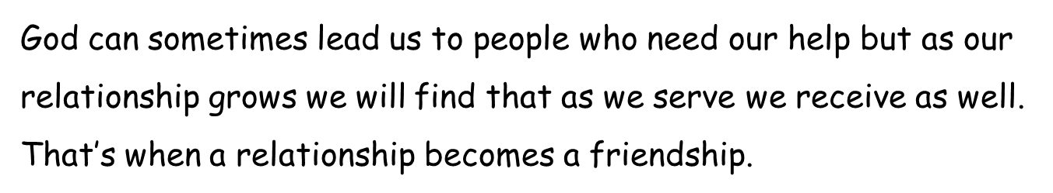
Take a moment to reflect and think.
What happened between Elijah and the widow?
Bob Hartman finishes with the words
serving… helps the one who serves in some surprising ways.
How do you think this was true for the widow in the story.

Slide 7
Serving with Joy Prayer
I’ll now lead a prayer, listen and if you wish to make the prayer your own join in with the Amen at the end.
Father God
Give us willing hearts to serve others with joy
and bring them help and comfort.
Give us humility to accept help and service from others
with thankfulness and grace.
Amen.

Slide 8

Let’s sing

Slide 9
Service: Sent By The Lord I Am
Translation © George Maldonado
Sent by the Lord am I;
My hands are ready now
To make the earth a place
In which the kingdom comes.
Sent by the Lord am I;
My hands are ready now
To make the earth a place
In which the kingdom comes.
The angels cannot change
A world of hurt and pain
Into a world of love,
Of justice and of peace.
The task is mine to do,
To set it really free.
O help me to obey;
Help me to do your will.
(Repeat 3 times)

Slide 10
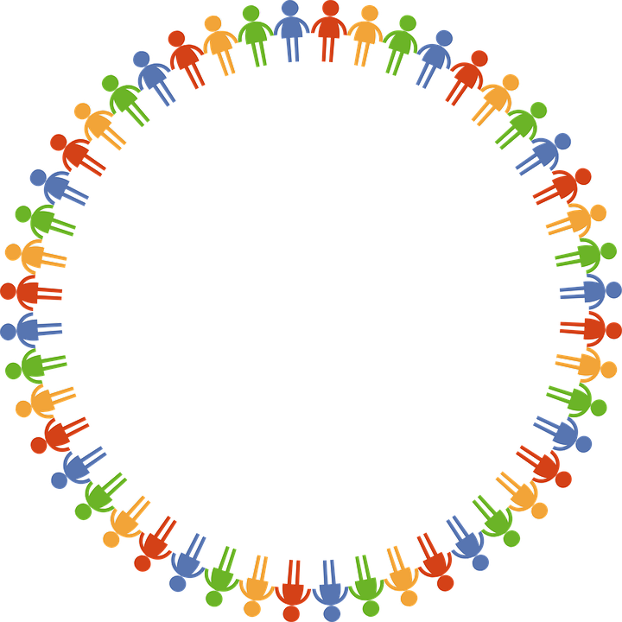
Dear God
Thank you for our school
and the amazing opportunities we have.
Thank you God
Thank you for all the work we do and the new things we learn.
Thank you God
Thank you for our church and school community.
Thank you God
Help us to make the right decisions.
Help us God
Help us to consider the needs of others.
and to be a good friend.
Help us God
Hear our prayer
Amen
Care
Inspire
Achieve

