Slide 1
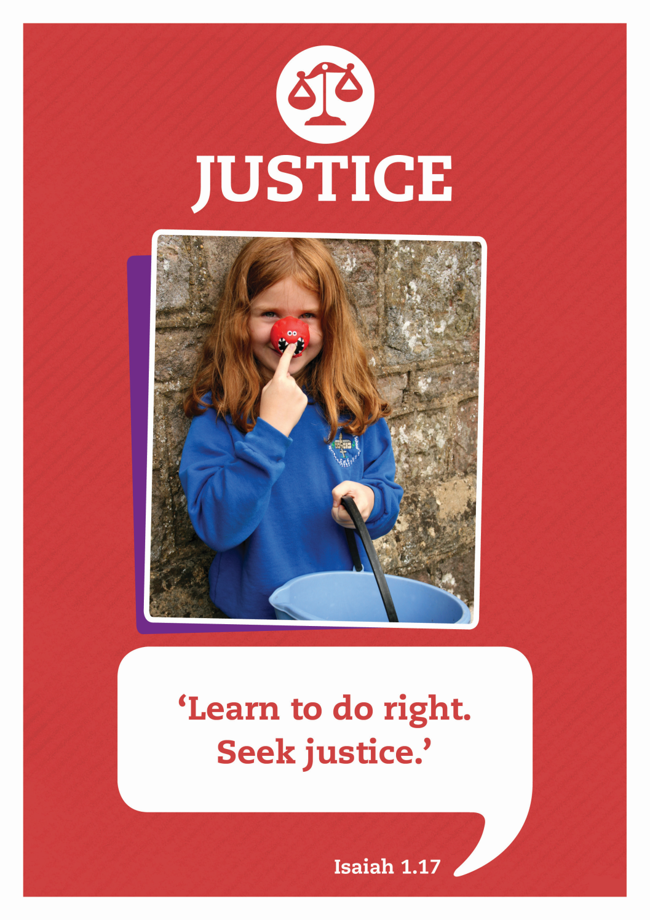

Slide 2



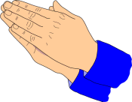


Care
We have gathered in the name of
God the father, Son and Holy Spirit,
to worship together
and think about our value justice.
Inspire
Achieve

Slide 3

Keeping
God’s Rules

Slide 4

Some of you may recognise this book and know what it is for.

Slide 5





Do you know what these signs mean?
We need rules of the road to make sure everyone knows how to behave and keep safe.

Slide 6

Story: The Ten Commandments
Long ago God wanted to show his people how to behave towards one another and treat each other justly.
He gave Moses, who was the leader of the people, some special rules.
They became known as the Ten Commandments.

Slide 7
The Ten Commandments
video
https://www.youtube.com/watch?v=OaCIq4q9Xuc

Slide 8

Reflecting
Take a few moments to think about
the ten commandments
Are they something you would like to try and follow?
Do you think some are easier to stick to than others?
What could you do to show that you love your neighbour as you love yourself?

Slide 9
A prayer for living well
Dear Lord,
God of justice and mercy,
You love us and want the best for us.
Thank you for helping us to know the right way to live.
May your ways be our ways,
So that all that we do and say is honouring to you.
In the name of Jesus,
Our Saviour and guide.
Amen

Slide 10

Let’s sing

Slide 11

Justice: Celebrate Life
Written by Andrew & Wendy Rayner, Wendy House Music
We stand united; Children, as one
Future for all of the world.
We join together from every land
Part of the family of God.
Everyone precious, everyone loved
All of us known by our name.

Slide 12
Celebrate life, this gift we are living.
Celebrate hope, for all of mankind.
Celebrate love to share with each other.
Celebrate life, hand in hand.
We pray for freedom, mercy and peace
Justice for all of the world.
We ask God’s blessing on every land
Longing for each child to know
Everyone precious, everyone loved
All of us known by our name.

Slide 13
Celebrate life, this gift we are living.
Celebrate hope, for all of mankind.
Celebrate love to share with each other.
Celebrate life, hand in hand.
Celebrate life, this gift we are living.
Celebrate hope, for all of mankind.
Celebrate love to share with each other.
Celebrate life, hand in hand.
Celebrate life!

Slide 14
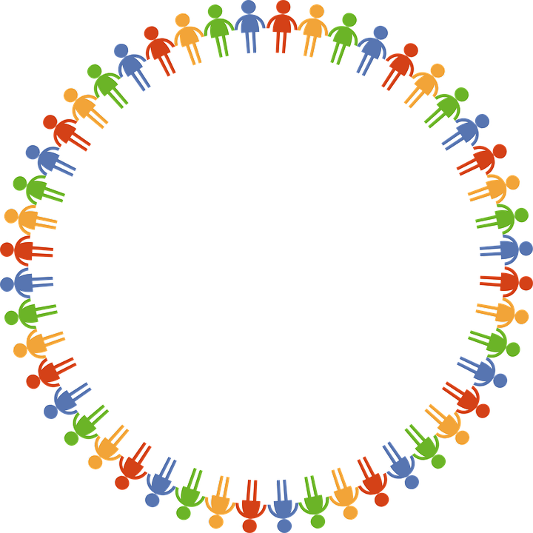
Dear God
Thank you for our school
and the amazing opportunities we have.
Thank you God
Thank you for all the work we do and the new things we learn.
Thank you God
Thank you for our church and school community.
Thank you God
Help us to make the right decisions.
Help us God
Help us to consider the needs of others.
and to be a good friend.
Help us God
Hear our prayer
Amen
Care
Inspire
Achieve

