Slide 1


Slide 2






Care
We have gathered in the name of
God the Father, Son and Holy Spirit,
to worship together
and think about our value truthfulness.
Inspire
Achieve

Slide 3
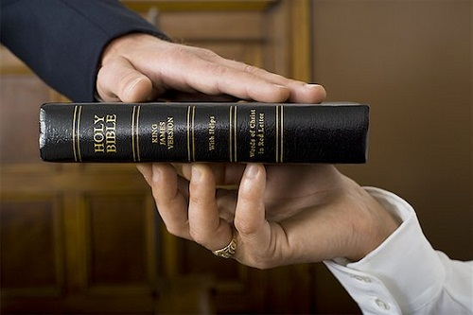
Before people begin to give evidence in a court of law, they are invited to hold a Bible and say the words:
“I promise before Almighty God that the evidence which I shall give shall be the truth, the whole truth, and nothing but the truth.”
In other words they promise to say only what they know to be true, not to repeat gossip and not to exaggerate or miss bits out.

Slide 4

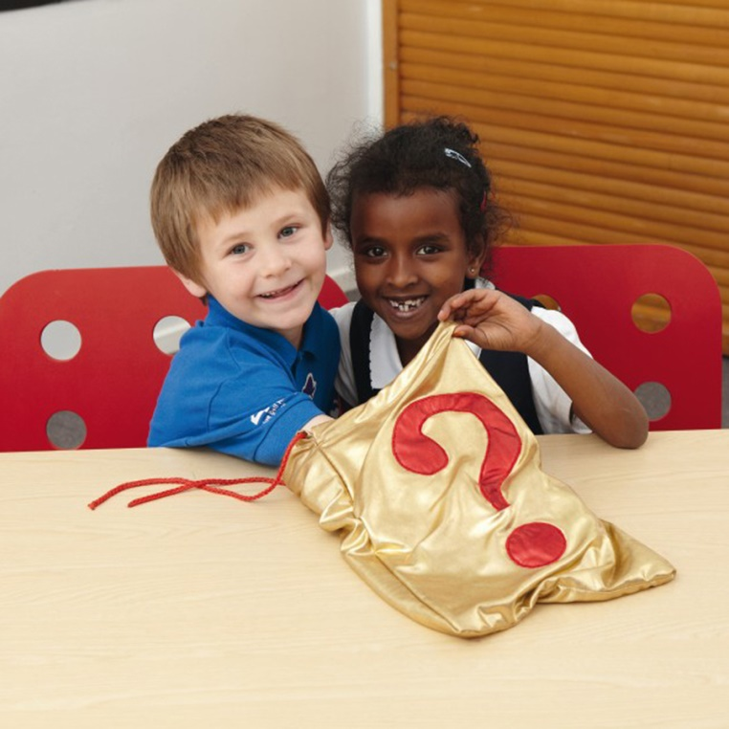
Have you ever tried to identify the contents of a feely bag or box without peeping?
Is it always easy? Or can it be a little tricky?

Slide 5



It is difficult to know how things really look when it’s dark. You might be able to feel what the object is, but not what colour it is.
But the light reveals the whole object.

Slide 6

Jesus said…
Why do you think he said this?

Slide 7
When someone tells the truth it is as if a light has been switched on and things are clearer to see.
If someone tries to cover or hide the truth it becomes confusing and harder to work out what is real or true.
Sometimes we only see part of the picture, and part of the truth can be misleading.

Slide 8

TRUTH IS….
Trustworthy words and actions
Respect for doing the right thing
Uncovering the full picture
Telling it as it is
Having all the facts
Which line do you think is the best way of describing truth and why?

Slide 9

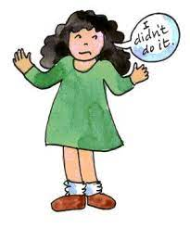

Take a moment to reflect and think.
Can you think of a time when you told only part of the truth, perhaps leaving some bits out on purpose?
May be you wanted to impress others, or make yourself look better.

Slide 10

\\\\
Responding
Most people would agree that it feels better inside if we tell the whole truth. This week when you are tempted to avoid the whole truth, remember the promise that people make in court:
“I promise before Almighty God that the evidence which I shall give shall be the truth, the whole truth, and nothing but the truth.”

Slide 11
Shining Lights Prayer
Lord Jesus, light of the world,
Help us to shine as lights,
to be truthful and honest in all we do.
Amen
I’ll now lead a prayer, listen and if you wish to make the prayer your own join in with the Amen at the end.

Slide 12

Let’s sing

Slide 13

Truthfulness: Seek Ye First
written by Karen Lafferty
Seek ye first the kingdom of God
And His righteousness;
And all these things shall be added unto you.
Hallelu, Hallelujah!
Hallelujah, Hallelujah, Hallelujah,
Hallelu, Hallelujah!

Slide 14
Ask, and it shall be given unto you;
Seek, and you shall find.
Knock, and it shall be opened unto you.
Hallelu, Hallelujah!
Hallelujah, Hallelujah, Hallelujah,
Hallelu, Hallelujah!

Slide 15
You shall not live by bread alone,
But by every word
That proceeds out from the mouth of the Lord.
Hallelu, Hallelujah!
Hallelujah, Hallelujah, Hallelujah,
Hallelu, Hallelujah!

Slide 16

Dear God
Thank you for our school
and the amazing opportunities we have.
Thank you God
Thank you for all the work we do and the new things we learn.
Thank you God
Thank you for our church and school community.
Thank you God
Help us to make the right decisions.
Help us God
Help us to consider the needs of others.
and to be a good friend.
Help us God
Hear our prayer
Amen
Care
Inspire
Achieve

