Slide 1
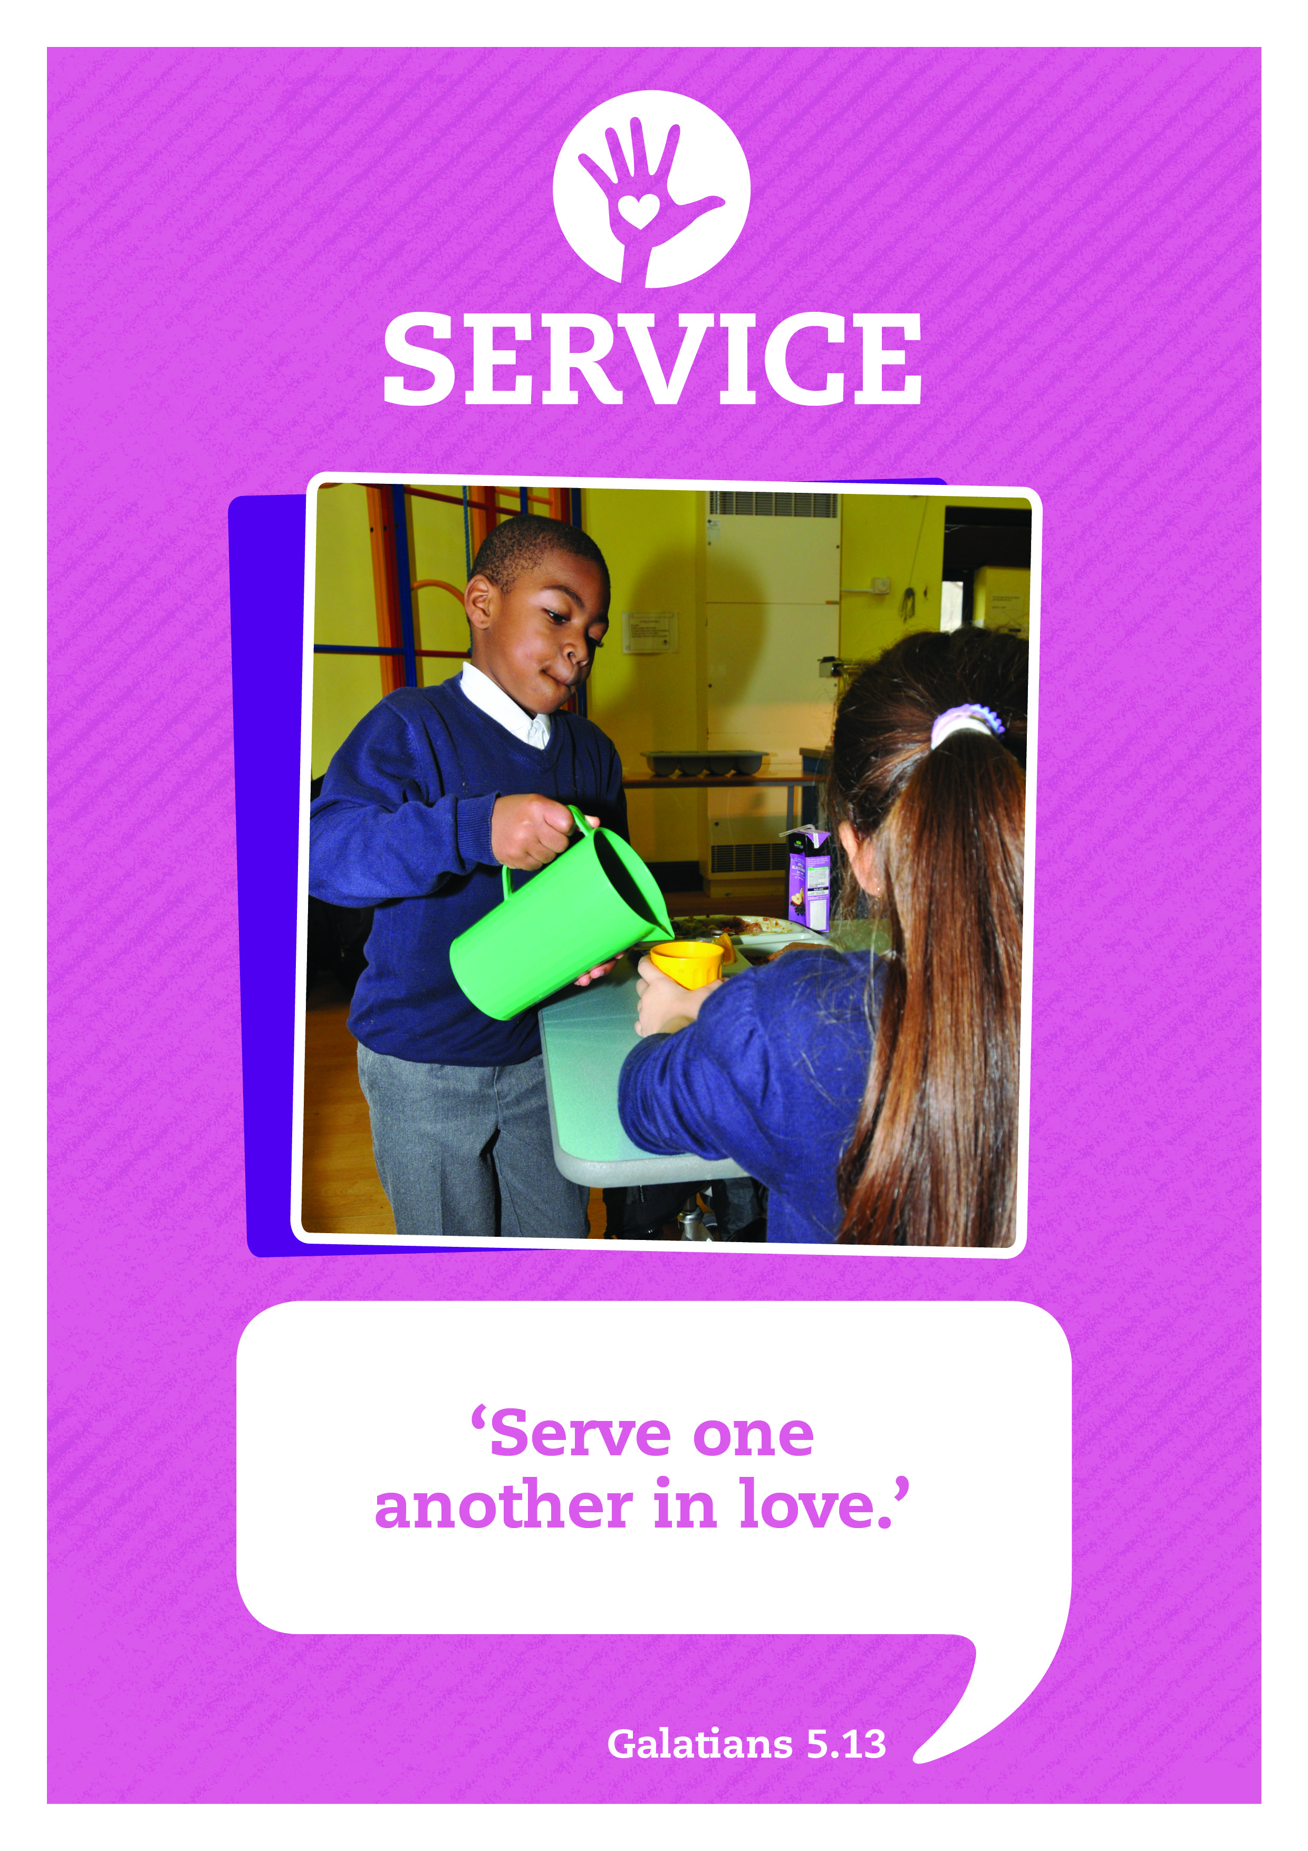



Music: Clarinet Concerto Adaglo
Composer: Mozart

Slide 2



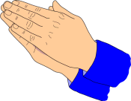


Care
This day may we know:
the love of God our Father,
the gift of God’s Son, the Servant King,
And the freedom of God’s own Spirit.
Inspire
Achieve

Slide 3
Today’s Bible verse is one that should be very familiar to you.
There were once two brothers, Simon and Andrew. They were fisherman. They worked very hard to catch enough fish to earn a living. Every day was pretty much the same, until one extraordinary day when their lives change forever. That was the day Simon and Andrew met Jesus.
Matthew 4 ¹⁸⁻²⁰
Walking along the beach of lake Galilee, Jesus saw two brothers, Simon and Andrew.
They were fishing, throwing their nets into the lake. It was their regular work. Jesus said to them,
“Come with me. I’ll make a new kind of fisherman out of you. I’ll show you how to catch men and women instead of fish.”
They didn’t really understand exactly what Jesus meant, but just dropped their nets and followed.

Slide 4

Drama: Barney and Bella
Bella: Hi Barney, did you hear the sad news?
Barney: That Mrs Bell is leaving?
Bella: Yes, I’m going to really miss her.
Barney: Mrs Bell has served as our lollipop lady for over 20 years. That’s a long time isn’t it?
Bella: What do you think made her so good at her job?

Slide 5
Drama: Barney and Bella
Barney: Well, we interviewed her in class yesterday. She said that many years ago she prayed that God would show her how He wanted her to serve others. The next day she was told about the Lollipop Crossing job at our school. She knew that this was what God wanted her to do. She loved helping people and she knew that helping us to cross the road safely made a big difference.
Bella: It certainly does. I feel safe when she’s there. That road is really busy.
Barney: Yes, and she’s hardly ever missed a day, even when she had that bad cough last year.
Bella: And I love it when she smiles and waves, even when it’s raining hard. Do you think all lollipop ladies smile a lot?
Barney: I suppose you could be a lollipop lady and get everyone safely across without smiling, but it’s much better to do it cheerfully.
Bella: Let’s hope the next person to do the job is as nice as Mrs Bell.
Barney: I think when I grow up I’d like to do a job that makes me smile a lot.
Bella: Come on, I’ve made her a card to say thank you; let’s go and give it to her.

Slide 6
Drama: Barney and Bella
Barney: Yes, and she’s hardly ever missed a day, even when she had that bad cough last year.
Bella: And I love it when she smiles and waves, even when it’s raining hard. Do you think all lollipop ladies smile a lot?
Barney: I suppose you could be a lollipop lady and get everyone safely across without smiling, but it’s much better to do it cheerfully.

Slide 7
Drama: Barney and Bella
Bella: Let’s hope the next person to do the job is as nice as Mrs Bell.
Barney: I think when I grow up I’d like to do a job that makes me smile a lot.
Bella: Come on, I’ve made her a card to say thank you; let’s go and give it to her.

Slide 8

Take a moment to reflect and think.
Jesus taught his followers to live a life of service to others, rather than, each one living for himself or herself.
His followers Simon and Andrew found that it wasn’t always easy. They left their jobs as fishermen, they left their families and they left the place where they had lived their while lives, all to follow Jesus.
Jesus doesn’t expect everyone to leave their homes and families behind to follow him but he does ask his followers to live lives of service to others.
What would you like to do when you get older?
Let’s have a quiet moment to think about it.

Slide 9
Service with a smile prayer
Dear Father
Help us to serve with a smile,
to take pleasure in helping others,
knowing that we are doing our best
to follow your example.
Amen
I’ll now lead a prayer, listen and if you wish to make the prayer your own join in with the Amen at the end.

Slide 10

Let’s sing

Slide 11
Service: Sent By The Lord I Am
Translation © George Maldonado
Sent by the Lord am I;
My hands are ready now
To make the earth a place
In which the kingdom comes.
Sent by the Lord am I;
My hands are ready now
To make the earth a place
In which the kingdom comes.
The angels cannot change
A world of hurt and pain
Into a world of love,
Of justice and of peace.
The task is mine to do,
To set it really free.
O help me to obey;
Help me to do your will.
(Repeat 3 times)

Slide 12
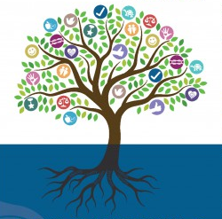
Fruits from the Roots
Think about people who serve in the community – what do they do and how does it make a difference?
You might think about a nurse, optician, refuse collector, doctor, dentist, mechanic, vicar, translator, street cleaner, shop assistant …

Slide 13
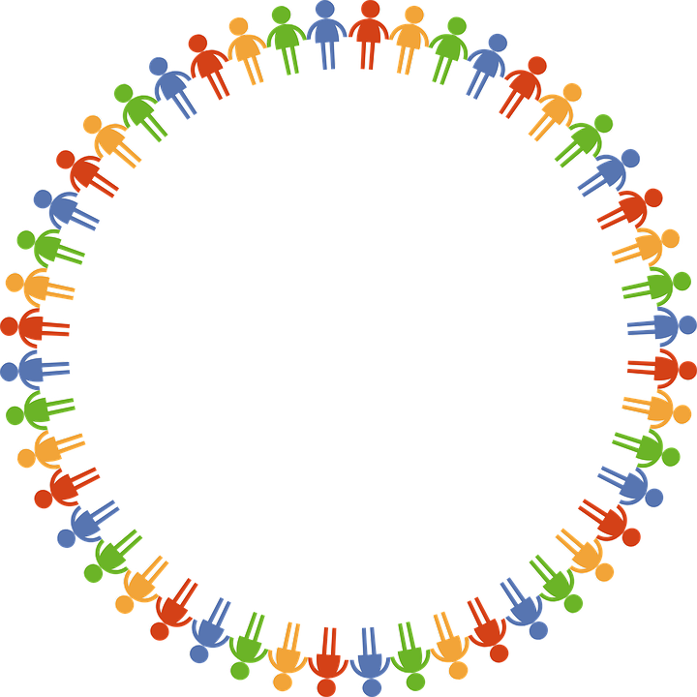
Dear God
Thank you for our school
and the amazing opportunities we have.
Thank you God
Thank you for all the work we do and the new things we learn.
Thank you God
Thank you for our church and school community.
Thank you God
Help us to make the right decisions.
Help us God
Help us to consider the needs of others.
and to be a good friend.
Help us God
Hear our prayer
Amen
Care
Inspire
Achieve

