Slide 1
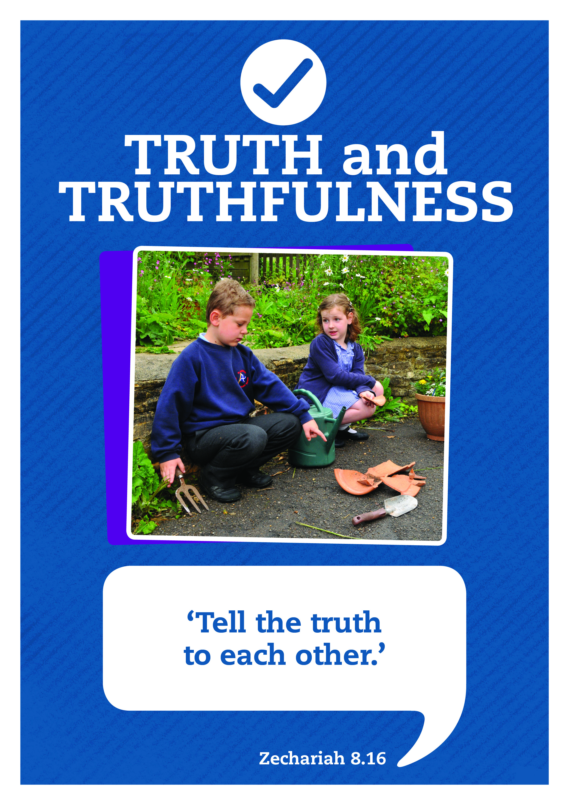

Making the Right Choices

Slide 2



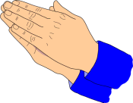


Care
We have gathered in the name of
God the Father, Son and Holy Spirit,
to worship together
and think about our value truthfulness.
Inspire
Achieve

Slide 3


We are thinking about truthfulness
and
making the right choices.
The logo for truthfulness is a tick.
Why do you think this is?

Slide 4
Our words of wisdom from the Bible for truthfulness are:
‘Tell the truth to each other.’
Zechariah 8 ¹⁶
Sometimes other people try to influence us to make the wrong choices and not tell the truth.
Listen to the choices that the children in the drama are faced with.

Slide 5

In the drams that you are about to listen to one of the characters can either make the
right choice
Or the
wrong choice

Slide 6
Dilemma 1
Darren: Hi Tom! Want to play in the match on Saturday?
Tom: You bet! That would be awesome!
Darren: It’s the under 11 Team. Sam’s got injured.
Tom: But you know I’ve had my birthday! I’m not under 11 anymore.
Darren: Who’s going to know that? I’m not going to tell them, are you?

Slide 7
Dilemma 2
Jasmine: Hey Katie, look what I’ve found!
Katie: Wow, a £10 note! Where did you find it?
Jasmine: On the school field. It was just blowing around in the wind. Someone must have dropped it. They’re going to be really worried about now.
Katie: It must be your lucky day! Now you can get that new bag you’ve been going on about.
Jasmine: Oh…. (thinks) I was going to hand it in.

Slide 8

Take a moment to reflect and think.
Tom and Jasmine were tempted to make the wrong choice. They can either do the ..
right thing
Or they could…
Make a different choice.
How could the dramas end?
What would you do?

Slide 9


Responding
Do you want to be someone that others trust to be truthful, whatever happens?
Or someone who when they are tempted, just gives in and tells a lie when it’s more convenient?

Slide 10
The Lord’s Prayer
Our Father in heaven, hallowed be your name,
Your kingdom come,
your will be done, on earth as in heaven.
Give us today our daily bread.
Forgive us our sins as we forgive those who sin against us
Lead us not into temptation but deliver us from evil.
For the kingdom, the power, and the glory are yours
now and for ever.
Amen.
I’ll now lead a prayer, listen and if you wish to make the prayer your own join in with the Amen at the end.

Slide 11

Let’s sing

Slide 12
Truthfulness: Seek Ye First
written by Karen Lafferty
Seek ye first the kingdom of God
And His righteousness;
And all these things shall be added unto you.
Hallelu, Hallelujah!
Hallelujah, Hallelujah, Hallelujah,
Hallelu, Hallelujah!

Slide 13
Ask, and it shall be given unto you;
Seek, and you shall find.
Knock, and it shall be opened unto you.
Hallelu, Hallelujah!
Hallelujah, Hallelujah, Hallelujah,
Hallelu, Hallelujah!

Slide 14
You shall not live by bread alone,
But by every word
That proceeds out from the mouth of the Lord.
Hallelu, Hallelujah!
Hallelujah, Hallelujah, Hallelujah,
Hallelu, Hallelujah!

Slide 15

Dear God
Thank you for our school
and the amazing opportunities we have.
Thank you God
Thank you for all the work we do and the new things we learn.
Thank you God
Thank you for our church and school community.
Thank you God
Help us to make the right decisions.
Help us God
Help us to consider the needs of others.
and to be a good friend.
Help us God
Hear our prayer
Amen
Care
Inspire
Achieve

