Slide 1
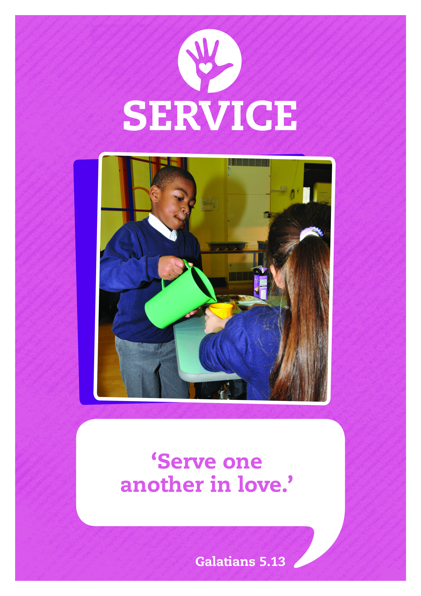


Using Our Talents To Serve
Music: Clarinet Concerto Adaglo
Composer: Mozart

Slide 2






Care
This day may we know:
the love of God our Father,
the gift of God’s Son, the Servant King,
And the freedom of God’s own Spirit.
Inspire
Achieve

Slide 3

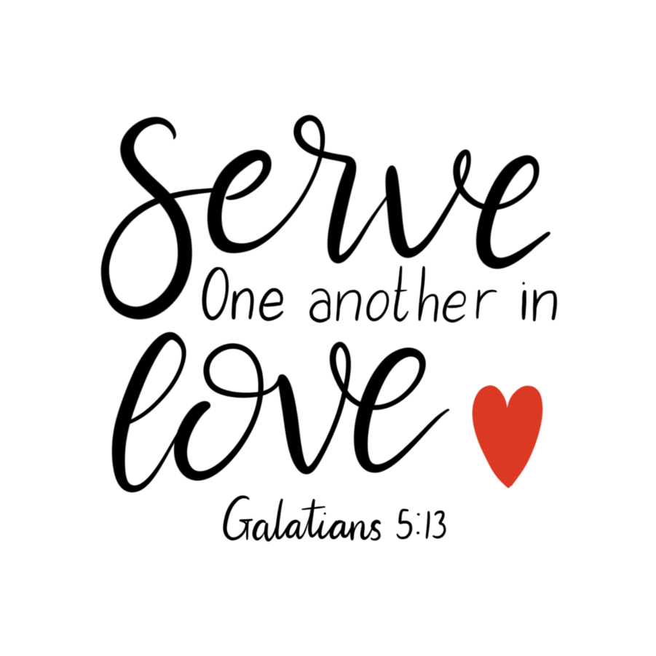
We all have talents that we can use to serve others or brighten up their lives. Perhaps you have a hidden talent waiting to be discovered!

Slide 4


I’m going to share some statements that are true of children in our school. May be one of them describes you.
I like sport … I could help organise a games tournament in school.

Slide 5
Who might this one describe?
I like being organised … I could help to keep the classroom or house tidy.

Slide 6
Who might this one describe?
I am a really good listener… maybe I could take more time to listen to a friend’s worries or volunteer to be a peer mentor.

Slide 7
Who might this one describe?
I love making people laugh and having fun… I could serve others by cheering them up and encouraging them when they are down.

Slide 8
All of these are ways of using your talents to serve others and make a difference.
Think of a talent you or a friend have and how that makes a difference.

Slide 9
Service is….
Spending time on others
Enjoying giving help
Responsibility in action
Volunteering willingly
I second, you first
Committing to a task
Everyone offering their talents and gifts
Which line do you think is the best way of describing service and why?

Slide 10

Reflecting
Think about what you are good at or something you enjoy doing.
It could be a practical skill (sport, music, maths etc) or a value you think is important such as being trustworthy, generous, or friendly.
How could you serve others by using one of them?
Maybe you could develop a hidden talent that no one knows about!
What would you write on a card hand to add to the talent tree?

Slide 11

Can you spot a good server?
Some of the best servers are people who quietly help others without any fuss, so you will need to be a good detective!

Slide 12
Serving others prayer
Father God
Thank you for the many different skills, gifts and qualities you have given us,
Help us to serve others with willing hands (lift hands in front of you),
with generous hearts (put hand on heart)
and with kind words (move hand away from mouth).
Use our eyes and ears to notice how others serve us (point to eyes and ears)
and remind us to show our gratitude and thanks
to our teachers (point towards a teacher),
helpers in school (point towards the playground),
our parents (point towards the school gates)
and our friends (sweeping gesture).
In serving others in love, may we also serve you.
Amen

Slide 13

Let’s sing

Slide 14
Service: Sent By The Lord I Am
Translation © George Maldonado
Sent by the Lord am I;
My hands are ready now
To make the earth a place
In which the kingdom comes.
Sent by the Lord am I;
My hands are ready now
To make the earth a place
In which the kingdom comes.
The angels cannot change
A world of hurt and pain
Into a world of love,
Of justice and of peace.
The task is mine to do,
To set it really free.
O help me to obey;
Help me to do your will.
(Repeat 3 times)

Slide 15
Signs of service
During the week look out for some acts of service.
When you notice someone performing an act of service this week ask them to put a marble in the jar.
We will them share some of these acts of service in our celebration assembly on Friday.
How many acts of service will you perform and spot?

Slide 16
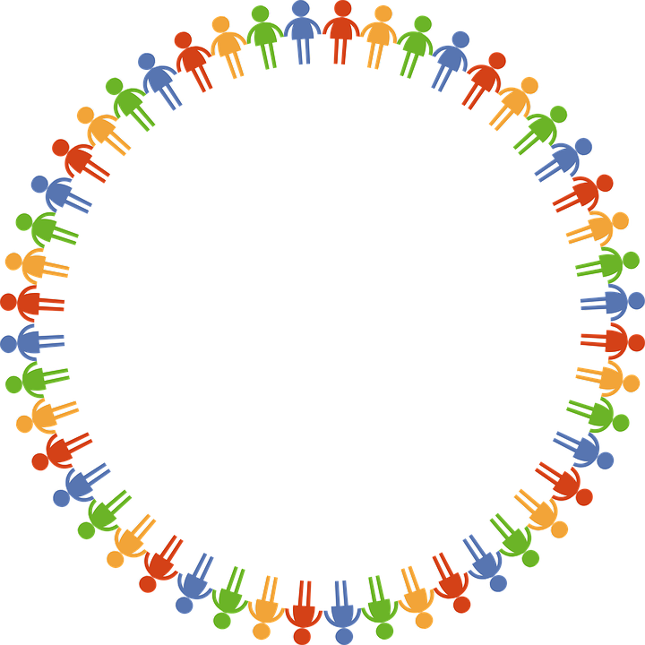
Dear God
Thank you for our school
and the amazing opportunities we have.
Thank you God
Thank you for all the work we do and the new things we learn.
Thank you God
Thank you for our church and school community.
Thank you God
Help us to make the right decisions.
Help us God
Help us to consider the needs of others.
and to be a good friend.
Help us God
Hear our prayer
Amen
Care
Inspire
Achieve

