Slide 1


Teaching Phonics

Slide 2
What is Sounds-Write
Sounds-Write is a proven Systematic Synthetic Program approach
based on the science of reading
and designed by teachers, for teachers.
It is a multisensory, code-oriented, comprehensive approach to literacy.

Slide 3
School: Daily Phonics Sessions
Skills:
Blending (sounds to words)
Segmenting (words to sounds)
Manipulation (swapping sounds)
Knowledge
Code
Conceptual (Initial Code)
  Sounds can be represented by spellings with one letter
  Some spellings are written with a double consonant e.g. ll, ff
  Some spellings are written with two letters e.g. ch, sh
Conceptual (Extended Code)
  A sound can be represented by more than one spelling eg. ai, ay, a-e
  A spelling can represent more than one sound eg. moon, book

Slide 4
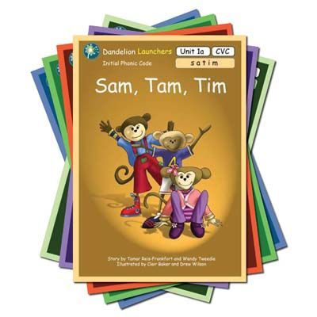
Home: Daily Home Readers
We use 'decodable readers’ at school, and the children are bringing these home to read.
Home readers enable your child to practise the sounds and spellings that they are learning.
Children need supported practice to build the skills of blending and manipulating sounds.
They need to opportunities to read again and again to gain fluency and reading stamina.
This is where you play a vital role.

Slide 5

The Initial Code: Reception

Slide 6


What are we trying to teach in the initial code?
We want the children to learn that letters are symbols for sounds, so that when they see the letters
< s > < a > < t >, they say and hear /s/ /a/ /t/ ‘sat'.
“Say the sounds read the word.”
sat
Say the sounds point to the letters
Read the word – gesture left to right under the word

Slide 7

Error Corrections
Please remember most learning comes from making and correcting errors
So how we do this is important.
Error: Child adds an /uh/ sound to letters eg muh.
Response: Say it like this /m/
Link to useful video clip
Saying the pure sounds youtube

Slide 8
What are we trying to teach in the initial code?
We want the children to learn that letters are symbols for sounds, so that when they see the letters
< s > < p > < o > < t >, they say and hear /s/ /p/ /o/ /t/ ‘spot'.
“Say the sounds read the word.”
spot
Say the sounds point to the letters
Read the word – gesture left to right under the word

Slide 9
Error Corrections
Please remember most learning comes from making and correcting errors.
So how we do this is important.
spot
Error: The child misses out a letter e.g says - sot
Response: Point to the missing letter (p) and say if this were sot this letter wouldn’t be here. Say the sounds and read the word.

Slide 10
Initial Code (Reception)
Unit | Word Structure | Sounds | High Frequency Words
IC Unit 1 | CVC | a, i, m, s, t
IC Unit 2 | CVC | n, o, p | is, a
IC Unit 3 | CVC | b, c, g, h | the, I
IC Unit 4 | CVC | d, e, f, v | for, of
IC Unit 5 | CVC | k, l, r, u | to are
IC Unit 6 | CVC | j, w, z | was
IC Unit 7 | CVC | x, y, ff, ll ss, zz | all
IC Unit 8 | VCC & CVCC | Using the previously taught sounds | come, some
IC Unit 9 | CCVC
IC Unit 10 | CCVCC, CVCCC, CCCVC
IC Unit 11 |  | sh, ch, th, ck, wh, ng, qu | there, their, these, what, where, who

Slide 11
The Extended Code: Year 1 and 2

Slide 12
What are we trying to teach in the extended code?
We want the children to learn that letters are symbols for sounds, so that when they see the letters
< s > < ee > < d >, they say and hear /s/ /ee/ /d/ ‘seed'.
“two letters but just one sound.”
seed
Say the sounds point to the letters
Read the word – gesture left to right under the word

Slide 13
Error Corrections
Please remember most learning comes from making and correcting errors.
So how we do this is important.
seed
“two letters but just one sound.”
Error: child say s/e/e/d/
Response: Point to /ee/ and say “two letters one sound /ee/”.
Point to /ee/ and say “say /ee/here
“Say the sounds and read the word.”

Slide 14
What are we trying to teach in the extended code?
We want the children to learn that a sound can be spelt in different ways.
play, train, great, cake
“one sound but different spellings.”
We want the children Initially the children are introduced to the more common ways of spelling a sound, then later (Y2) they will be introduced to more spellings
a, ei, ey, eigh
Say the sounds point to the letters
Read the word – gesture left to right under the word

Slide 15
Error Corrections
Please remember most learning comes from making and correcting errors.
So how we do this is important.
Error:
They spell rain as rayn
Response: Point to /ay/ and say
“This is a way of spelling /ae/but in this word it’s this spelling - ai.” “Say the sounds and write the word.”

Slide 17
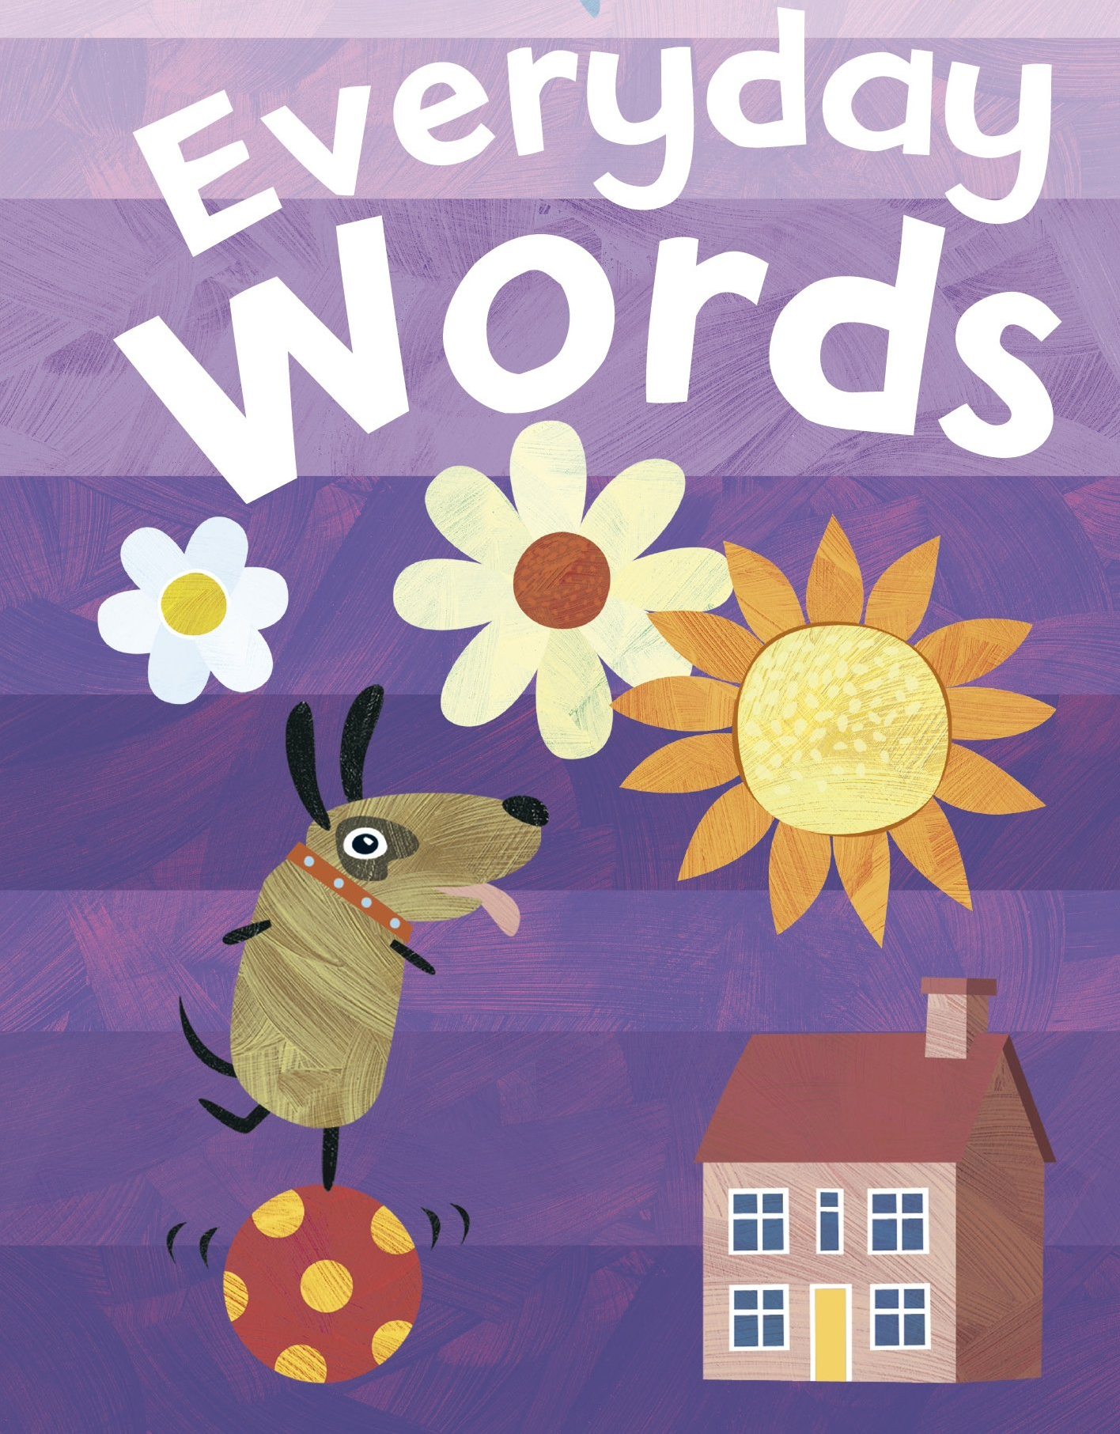
Everyday words
Some of the words in these 'decodable books' might contain spellings your child hasn't learnt yet. At the back of the book, you'll see a list of the words that your child might need help with. When your child comes to one of these words in their book, simply read it for them. If the word was 'the' and your child didn't know how to read that word, you could simply point to the word and say: 'This is 'the', just say 'the' here.

Slide 18
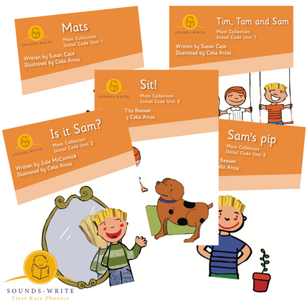
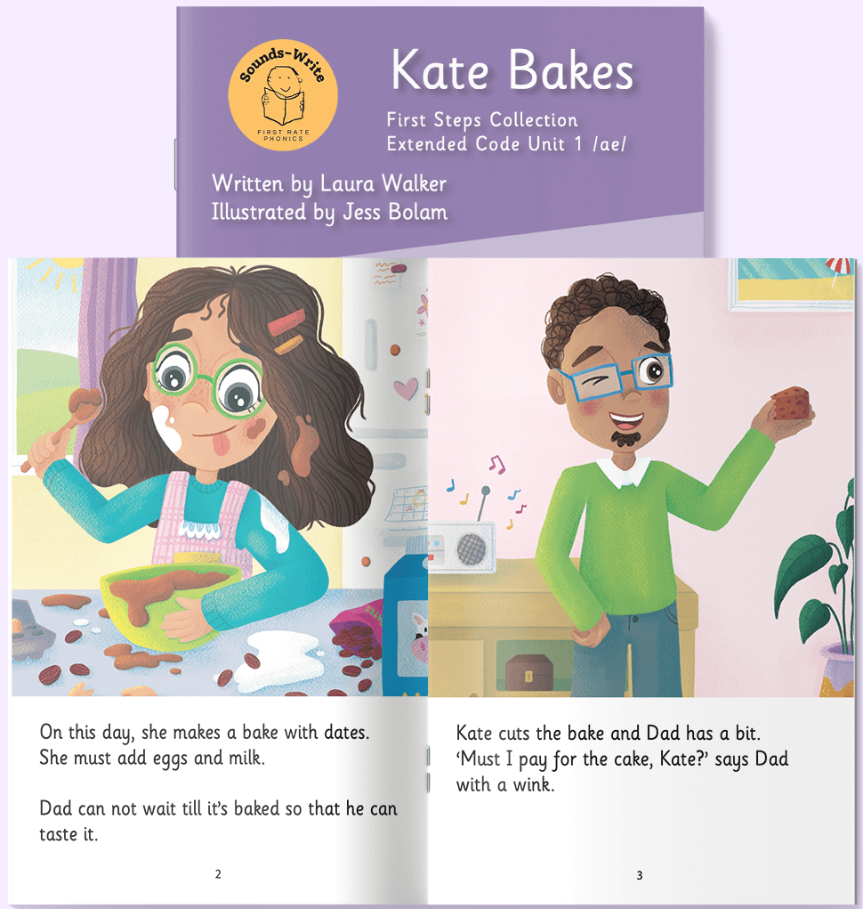
Home: Daily Home Readers
They are not the most interesting of stories, due to the limited number of words available to decode, but they are essential to building the skills needed to be a fluent and effective reader. So offer lots of praise, encouragement and modelling of the skills. The books need to be read multiple times if fluency is to be obtained.

Slide 19
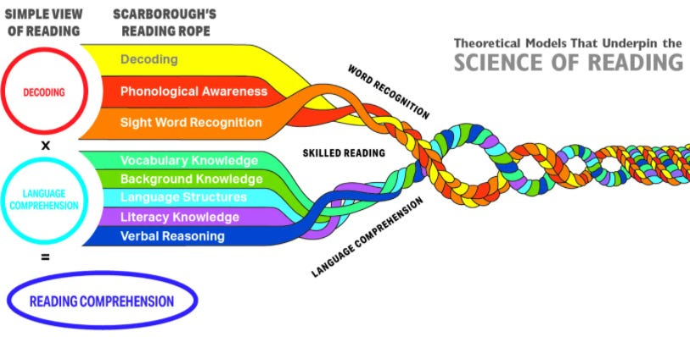
Phonics First approach acknowledges that there is much more to reading than just phonics

Slide 20
How do I provide a rich reading experience for my child?
Read a wide variety of books to your children, from classic picture books to non-fiction texts on topics that interest them. These can be books from the read together school books, the library or home.
Reading a wide variety of books to your child will:
promote a love of reading.
model what fluent reading ‘sounds’ like
model appropriate expression and phrasing (e.g. slight pauses at commas and full pauses at full stops)
Talk about the book and:
encourage your child to retell the main parts of the story
talk about the characters, plots and settings of stories and link these to the illustrations provided
discuss what was learnt from informational texts e.g. “What did you find out about spiders?”
compare the people and events in the texts with those in your own lives
select several words from the text (that your child would know) and ask them to put the word in a sentence - this is a powerful vocabulary building activity

Slide 21
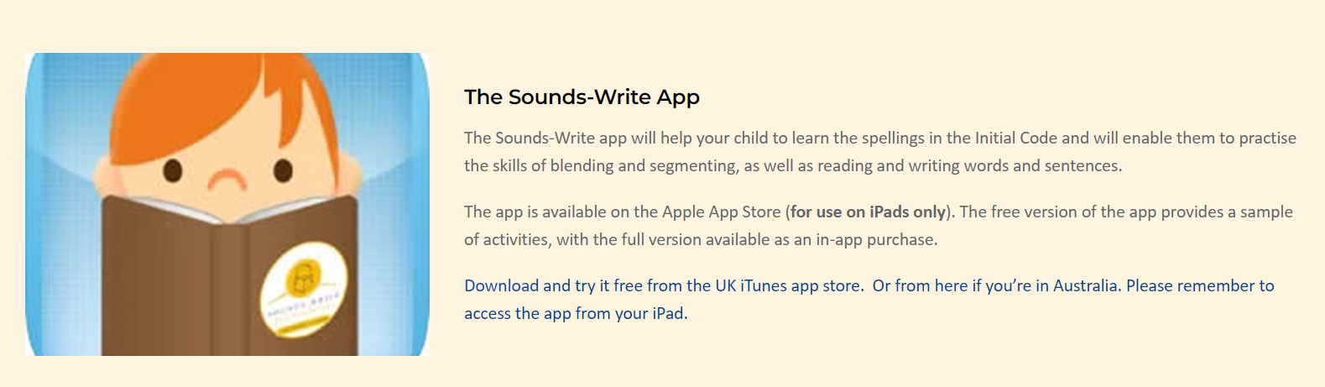
Sounds-Write Parent and carers course information

Slide 22


Letter-join Handwriting Home login
Tablet log-in
User name: qr9971
Swipe code: A capital ‘L’ shape starting at top left.
PC log-in
User name: qr9971
Password: home

Slide 23
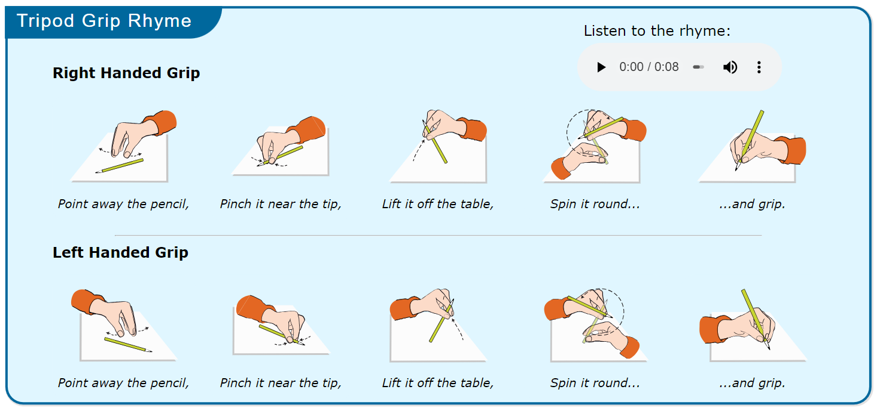

Slide 24


